Slide 1

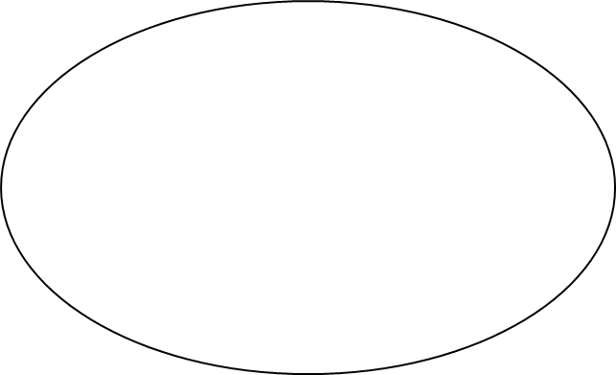
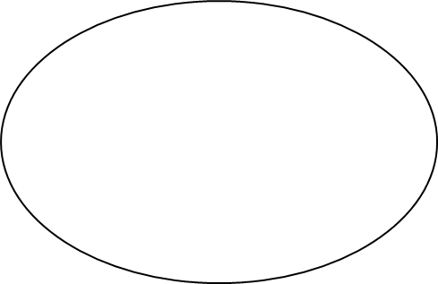

From the Anisa Model of Education
to The Wholistic Education System (WES):
A Multidimensional, Developmental Approach
W
E
S
William Keith Bookwalter, Ph.D., July 12, 2024
Notes:
WES represents my humble attempt to carry forward the development of the Anisa Model of Education created by Dr. Daniel C. Jordan with the assistance of his colleagues and doctoral students during a twenty-three-year period (approximately 1959 to 1982), especially during the 1970’s at the Center for the Study of Human Potential at the University of Massachusetts’ School of Education. Dr. Jordan, a Rhodes Scholar considered by many to be a genius, was inspired to create this model principally by the sacred scriptures of his religion, the Bahá’í Faith; the cosmology of Alfred North Whitehead, a British mathematician, logician, professor, and philosopher; and by his own studies, meditations, intuitions, and dreams.
Because Anisa, a Greek word meaning “Tree of Life,” was incorporated as the American National Institute for Social Advancement and its materials copyrighted, I needed to proceed with the development of ANISA under a new name. I chose the term “wholistic” rather than “holistic” because it emphasizes that WES seeks to educate the “whole” child and I find that practitioners more readily grasp the meaning of “whole” than the meaning of the Greek root “holos” (which also means “whole”). (See: https://www.merriam-webster.com/words-at-play/wholistic-word-origin-and-use)
I chose the term “system” because Dr. Jordan referred to the Anisa Model as a “system of education” and because Shoghi Effendi, the Head of the Bahá’í Faith from 1921 to 1957, called for the creation of a “system” of education. Hence, although it is also a science (see George Bondra’s seminal dissertation titled, “The Anisa Model: A Scientific Paradigm for Education and Its ImpIications for a Theory of Evaluation”), I chose not refer to it as a science of education because the field of education has also been, and will continue to be, advanced by methods that are not exclusively scientific and not always research-based*; for example, via the arts and other humanities, dreams, intuitions, and inspiration from sacred writings. WES is at once a spiritual and humanistic system of education; a model, a philosophy, and a science of education, hence, the term “wholistic.”
*The Reggio Emilia approach to education, for example, is a highly successful model that has no body of formal research to confirm its recognized success.

Slide 2
Handouts for:
The Wholistic Education System (WES)
  Synopsis
  Overview
  Diagram of the 11 Major Components
  Explanation of the Diagram of the 11 Major Components
  Table of Contents of forthcoming book
  First Principles and Corollary Principles
  Further Explanation of the Organizing Principle
  Basic Curriculum Framework Chart
  Supplementary Curriculum Framework Chart
  Theory of Administration
  Theory of Learning Community-Environment Relations
  Theory of Evaluation
  Possible Applications at Educational Institutions
Notes:
This slide program presents an introductory overview of WES. The concepts are abstract but broadly applicable. To understand their relationships the program, its components, its concepts, and its documents need to studied multiple times. As aids for understanding, whenever possible, examples or metaphors from nature, from formal educational settings, and from everyday life are provided for the key concepts. Examples for all major concepts will be included in the book to be titled The Wholistic Educational System: A Multidimensional, Developmental Approach.
The notes in this slide program are general. I modify and supplement them depending on the audience: public school faculties, secular private school faculties, religious school faculties, university faculties, fellow Anisa colleagues, or Bahá’í’ educators. For ease of reading, the presenter can skim over what I call “foundational sources.” These were included only to show the strength of the research base.
The Curriculum Design handout is from the 1978 proposed Louhelen Bahá’í School project in Davison, Michigan. It includes religion but in the U.S., Anisa was implemented in public schools that did not teach this subject. To my knowledge, the strongest implementation of the Anisa Model of Education was at the Marymount School in Barranquilla, Colombia, a private, Catholic-based, bilingual (Spanish-English), American-type school, during a six-year period (1987-1993) that afforded the opportunity to develop a curriculum strand for spiritual competence.
The attached curriculum design needs to be updated and extended beyond age fifteen, through early adulthood, the working years, and the retirement years.

Slide 3
Part 1: The Origin and Application of Anisa
Part 2: The Development of Anisa as WES
Part 3: WES: Its First Principle,
Philosophy of Education & Theories
Part 4: The Application of WES
to Institutions of Higher Education
Notes:
There are 145 slides in all. The presentation can be adapted depending on the time available. The mínimum amount of time needed for an overview is 45 minutes and can include just a dozen slides and handouts (hard or digital copies) for later persusal by the participants.

Slide 4
Part 1:
The Origin and Application of Anisa
Notes:
Parte 1 contains about 30 slides covering the history of the origin, development, implementation, and research results of the Anisa Model of Education.

Slide 5
The Anisa Model of Education:
was an enterprise that, for the first time in history, provided a scientific foundation for the field of education;
was conceived by the Rhodes Scholar and renowned genius, Dr. Daniel C. Jordan;
was carried out at a sequence of five U.S. universities from 1959 to 1982; and
was researched, developed, implemented, and evaluated by about thirty doctoral students guided by Dr. Jordan at the Center for the Study of Human Potential, University of Massachusetts.
Notes:
“Anisa” comes from a root word that refers to “the tree of life” and symbolizes beauty, fragrance, shelter, shade, and perpetual cycles of fruition.

Slide 6
The Anisa Model rests on the process philosophy of British mathematician, logician, and philosopher, Alfred North Whitehead.
This organismic philosophy views reality as composed of organic processes or events rather than solid, mechanically operating, material substances.
From this cosmology, a coherent and comprehensive body of theory concerning human development and learning, curriculum, pedagogy, administration, and evaluation were derived.
The propositions in the theories, to the extent possible, were checked against the findings of empirical studies thereby providing inductive support for the theories.
Notes:
For an analysis of the compatibility of the process philosophy of Alfred North Whitehead and the teachings of the Bahá’í Faith regarding creation, see the article “Process Philosophy and the Bahá'í Writings: An Initial Exploration” by Ian Kluge which is accessible at:
https://bahai-library.com/kluge_process_philosophy.
An example of the review of empirical studies: Conway, P. (1975). Volitional competence and the process curriculum of the Anisa model. In P. Conway (Ed.), Development of volitional competence: Selected readings. New York: MSS Information Corporation. Retrieved July 2005, from http://www.edpsycinteractive.org/anisa/development/volitional_competence.pdf

Slide 7
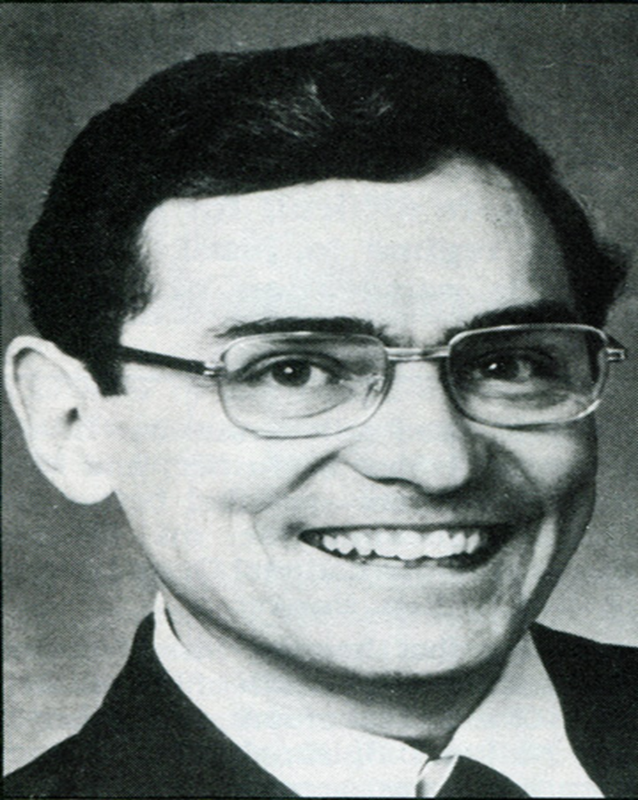
Dr. Daniel C. Jordan
(1932-1982)
Notes:
- At the age of 13 he entered the University of Wyoming, graduating at the age of 17 with a Bachelors in Music.
- Regarding his religion, in 1948, at the age of 16, he became an atheist. At the age of 18 he was introduced to the teachings of the Bahá’u’lláh and in 1954 he joined the Bahá’í Faith.
- At the age of 16, in his third year at the University, he became the first American to be awarded a Rhodes Scholarship to study music at Oxford University in London.
- At Oxford he earned both a bachelors and a masters in musical composition, theory and the history of music, and was starting his doctoral work in musicology when he was drafted into the U.S. Army.
- This experience and the Writings of Bahá’u’lláh, the Prophet-Founder of the Bahá’í Faith, inspired him to turn down an offer to play Beethoven's “Emperor's Concerto” with the Oslo Symphony, which most likely would have set him on the tour circuit as a concert pianist, and to dedicate his talents to the advancement of civilization in general and the advancement of education in particular.
- At he age of 27, from 1959 to 1964, he started a second career at the University of Chicago where he completed his bachelor’s degree studies and earned a master’s degree, a Ph.D. and carried out post-doctoral studies. His areas of study included biology; brain chemistry related to memory, emotion, and learning; social anthropology, sociology, psychology, and human development from conception to death.

Slide 8

Notes:
The biography titled A Most Remarkable Man—The Life and Legacy of Daniel C. Jordan: Musician, Philosopher, Psychologist, Educator by Harry P. Massoth was published in 2022. It contains biographical information obtained primarily from a tribute I wrote in 1992 titled, “Who Was Dr. Daniel C. Jordan?” Mr. Massoth gathered some additional information on Dr. Jordan’s life from his long-time collaborator, Dr. Donald T. Streets and included two collections of Dr. Jordan’s articles; one regarding Bahá’í topics and the other on the Anisa Model of Education. Because Anisa was created for U.S. public schools, it made few references to spiritual education. Nevertheless, Dr. Jordan’s views on this aspect of education can be found in his writings on the Bahá’í Revelation which were written for Bahá’ís and those interested in its teachings rather than for the public or for profesional journals.

Slide 9
“Man is the supreme Talisman. Lack of a proper education hath, however, deprived him of that which he doth inherently possess. . . . Regard man as a mine rich in gems of inestimable value. Education can, alone, cause it to reveal its treasures, and enable mankind to benefit therefrom.” —Bahá'u'lláh
Gleanings from the Writings of Bahá'u'lláh, CXXII
Notes:
In his lectures to Bahá’í audiences, Dr. Jordan would quote this and other passages from the Bahá’í writings. He wrote an article titled “In Search Of The Supreme Talisman: A Bahá’í Perspective On Education.”

Slide 10
“Address yourselves to the promotion of
the well-being and tranquillity of the children of men. Bend your minds and wills to the education of the peoples and kindreds of the earth, that haply the dissensions that divide it may, through the power of the Most Great Name, be blotted out from its face, and all mankind become the upholders of one Order, and the inhabitants of one City.”
–Bahá’u’lláh
Gleanings from the Writings of Bahá'u'lláh, CLVI
Notes:
Dr. Jordan was also want to quote this passage from the writings of Bahá’u’lláh. In addition to the article on human beings being the supreme Talisman, he wrote the following articles on topics relating directly or indirectly to spiritual education from a Bahá’í perspective: “Becoming Your True Self,” “A Bahá’í Perspective On Education,” “The Meaning Of Life,” “Divine Attributes,” “Spiritual Education,” and “Knowledge, Volition, and Action.” All of these have been reprinted in his biography A Most Remarkable Man.

Slide 11
“We are only just realising that the art and science of education require a genius and a study of their own; and that this genius and this science are more than a bare knowledge of some branch of science or of literature.”
--Alfred North Whitehead
(Aims of Education, 1929, p4)
Notes:
Alfred North Whitehead was a genius himself, but in fields other that education. He had his own general theory of relativity and understood thoroughly quantum mechanics and work of Einstein. Some of his work was used by Albert Einstein. Dr. Jordan believed that Whitehead grasped Einstein’s work but not the other way around.

Slide 12
The Anisa Model of Education
A Timeline
- Conceived, implemented, developed, field tested, and evaluated:
- 1959-1964: University of Chicago
- 1965-1967: Indiana State University, Terre Haute
- 1968-1978; University of Massachusetts, Amhurst
- US$1,000,000+ in grant funds for its development.
- 1971-1978: Field tested in several public schools
- Became core curriculum at two schools of education:
- 1978-1979: California American University
- 1979-1982: National University, California
- This author learned about, implemented, and developed Anisa as The Wholistic Educational System (1971-present)

Slide 13
Not withstanding advances in psychology and sociology, there is no science of education. Why not? There is a science of medicine furnishing doctors with reliable theory and autonomy; but instead of a science of education providing teachers with the theory and autonomy they need, we have government officials and school administrators telling teachers how and what to do.
--Jean Piaget (1970)
Notes:
The search of the Anisa team to understand humanity’s cumulative understanding of the nature of human beings, the object of human education and schooling, led them into a field in which they, as educators, were not well-grounded – the field of philosophy. They discovered that there had been a paradigm shift in our understanding of the nature of reality (which includes the nature of human beings). It can be described as a shift from seeing reality composed not of solid particles (the reductionist, mechanistic paradigm) but of processes, occasions, or events characterized by the continual actualization of potentiality (the organismic or process paradigm). This new paradigm was captured by the minds of a group of thinkers, scientists and philosophers and is being applied to a broad range of fields of human endeavor. A major expression of this new paradigm was found in the cosmology or philosophy of organism of Alfred North Whitehead as set forth in various books that he wrote, primarily Process and Reality (1929). In its formulation Whitehead took into account the discoveries of quantum mechanics which, in his time, was, and today still is, leading-edge science. He also stated, “The philosophy of organism seems to approximate more to some strains of Indian or Chinese thought than to western Asiatic or European thought.” (Process and Reality, 7) I would add that it also approximates more to Native American Indian thinking that it does to western thought.
When I present the theories of WES to teachers, I sometimes get the response that I am being too theoretical and that I need to give them something more practical and immediately useful. Over the years I become better at offering immediate, practical applications. I also explain that these are only examples of possible practices and that, if they want to become “science practitioners,” there is nothing more practical than a good theory. When they are faced with a situation in their students’ learning that they have never experienced previously, they can go back to the theory in order to generate new “propositions” for learning activities. Research-based theory (confirmed later with superior learning outcomes of their students) will also increase their autonomy as teachers by enabling them to justify their practices in the face of inferior, mandated practices and programs.

Slide 14
I would go so far as to say that the lack of a common frame of reference and the absence of any unifying concepts and principles, is now, if not the world's major disease, at least its major serious symptom.
--Julian Huxley (1960), UNESCO's first director general
Notes:
During the lectures of Dr. Jordan that I was privileged to attend, I recall him explaining that the search of the Anisa team was to find a unifying, first principle that was so fundamental that nothing else could be more fundamental. A system of education could then be generated from such a first principle and built upon a solid foundation that would last for centuries.

Slide 15
There can be no science of education until the vast knowledge available about human growth, development, memory, emotion, learning, and behavior is organized and put into usable form. But there is no hope of organizing this knowledge and making it usable without an organizing principle. The primary reason we have no science of education is the lack of such a principle.
--Daniel C. Jordan, former Dean of Education, National University, San Diego
Notes:
Dr. Jordan found an organizing principle in the cosmology of Alfred North Whitehead.

Slide 16
Dr. Jordan searched for an “organizing principle” from which to generate “a comprehensive theory for understanding man,” a theory broad enough “to integrate all that we know about human beings in a way that would enable us to create an educational system that maximally fosters growth and development.”
(Jordan and Streets, Young Children, Vol. XXVIII, No. 5, June 1973, p291.)
Notes:
Later in this presentation, the major sources that informed this quest will be listed.

Slide 17
A first principle is an axiom that cannot be deduced from any other within that system. For example, from Euclid we have the principle:
“Things which equal the same thing also equal one another.” (For example, 2+4=6 & 3+3=6, therefore, 2+4=3+3)
From Rudolf Clausius we have the First Law of Thermodynamics:
“Energy cannot be created or destroyed; it can only be converted from one form to another.”
From these hundreds of propositions have been deduced.

Slide 18
Dr. Jordan researched these bodies of knowledge about human nature and the purpose of life:
- Sacred scriptures of the world religions (especially those of the Bahá’í Faith)
- Philosophy (Parmenides [475 BC] to Whitehead [1861-1947]) and other humanities, including the arts
- Science (especially human development and learning)
Notes:
I once asked Dr. Streets, Dr. Jordan’s primary collaborator, if he knew where and when Dr. Jordan first came across the work of Alfred North Whitehead. He wasn’t certain but he believed that it was probably during his studies at Oxford. The later review of other thinkers on human nature as expressed in the dissertation of Paul Shepard, according to Dr. Streets, was simply another expression of Dr. Jordan’s perfectionism and search for certainty.

Slide 19
Humanities-inspired, Philosophical & Scientific Thinking on Reality & Humanity:
Sources Reviewed by Anisa Team
Parmenides
Socrates
Aristotle
Plato
Copernicus
Galileo
Descartes
Isaac Newton
John Locke
G. Berkeley
David Hume
David Hartley
Kant
James Mill
John Stuart Mill
Alexander Bain
J. F. Herbart
M. W. Drobisch
Gustav Fechner
Wilhelm Wundt
Titchner
Wilhem Dilthey
Franz Brentano
Carl Jung
Alfred Whitehead
Jean Piaget
Materialism
Organism
Associationism
Structural Psychology
Functional Psychology
Behaviorism
Gestalt Psych.
Psychoanalysis
Field Theoretical Psych.
Personality Theory
Humanistic Psych.
Organismic Psych.
Critical Realism
Speculative Phil.
Psycho-Metaphysics
Evolutionary Theory
Personality Develop.
Personal Identity
Notes:
Most of these were reviewed in the dissertation of Paul Shepard: Process and Personality: Toward a Unification of Psychological Theory and Educational Practice. Raymond Shepard, Ed. Doctoral Dissertation, School of Education, University of Massachusetts Amherst, 1972. https://scholarworks.umass.edu/cgi/viewcontent.cgi?article=3733&context=dissertations_1

Slide 20
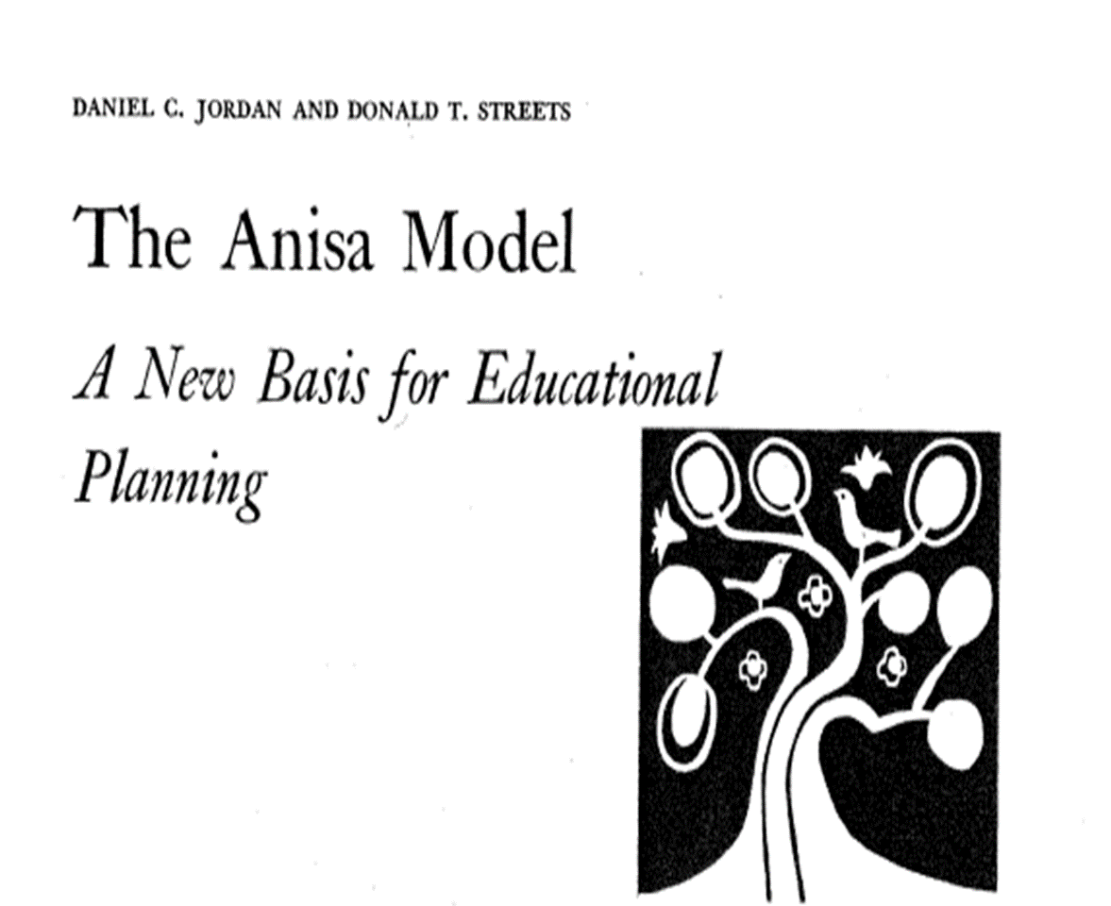
Notes:
The Anisa Model was implemented at public schools in Massachusetts, Connecticut, Maine, and Ohio. Dr. Jordan stated that the extrapolation of the results of research on student learning at these schools indicated that, if the model were to be continued with students to the age of 15 that they would be, at that age, prepared for post-graduate, university studies!

Slide 21
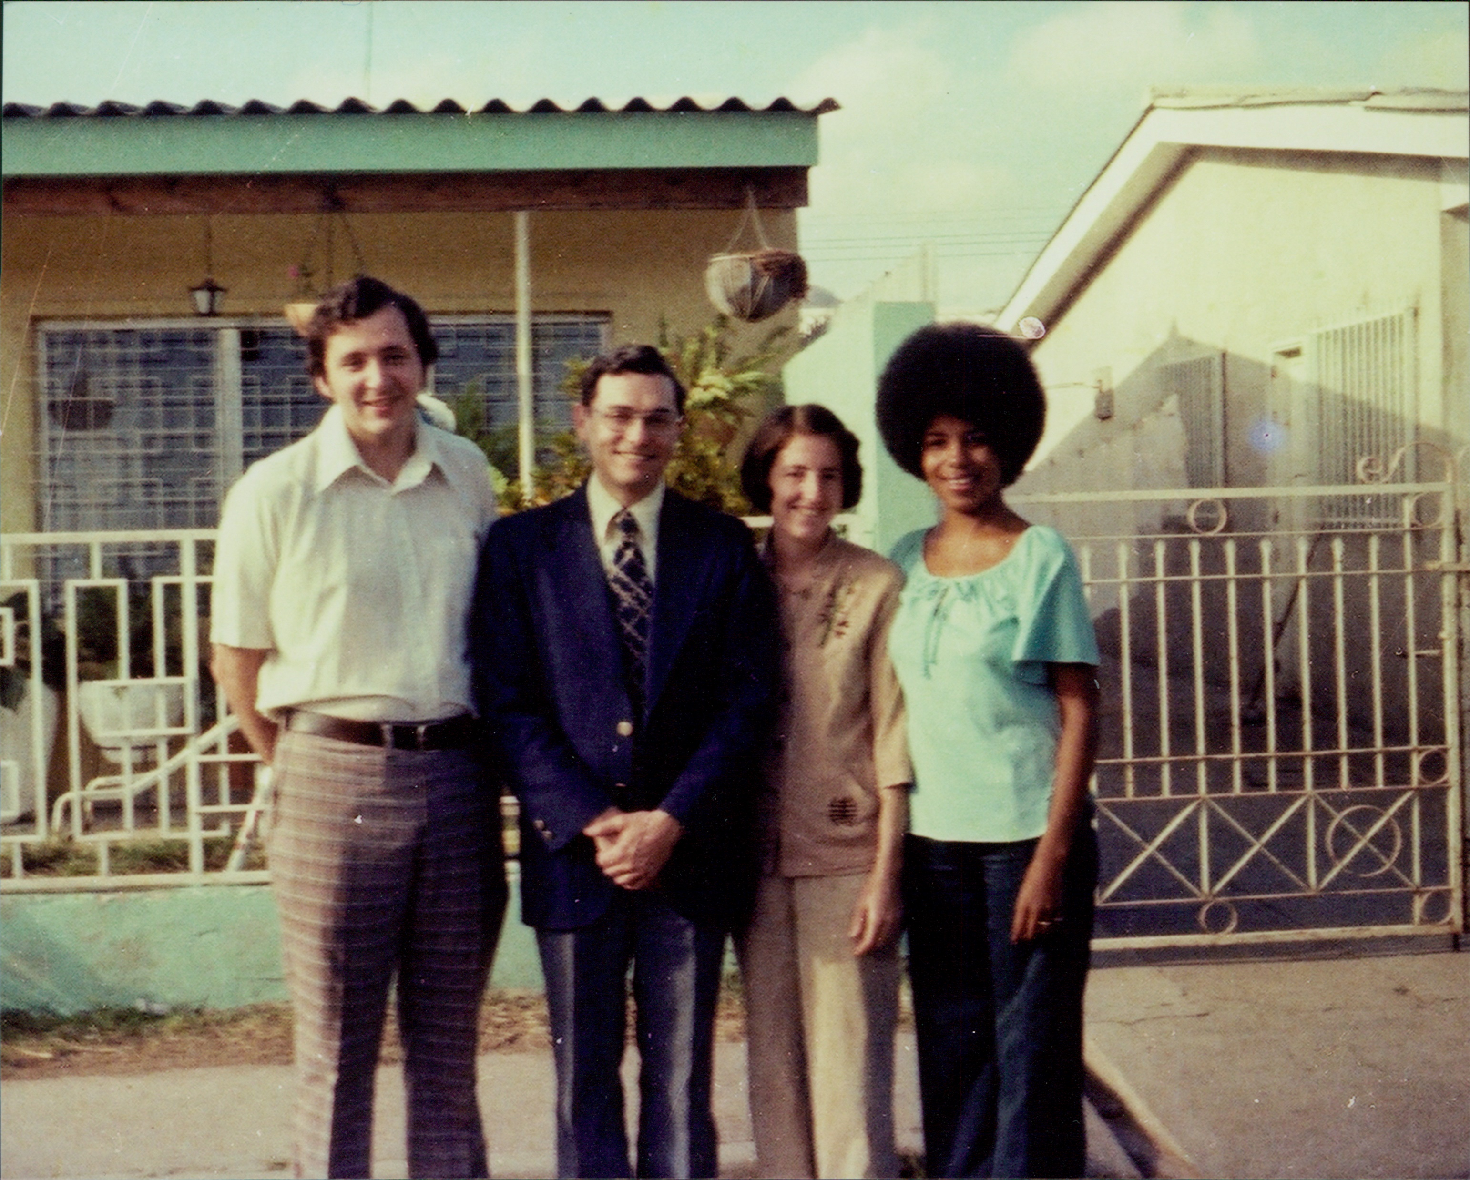
Notes:
Tegucigalpa, Honduras, 1979; left to right: Wm Keith Bookwalter, Daniel C. Jordan, Jaqueline Bookwalter, Ellen McAllister-Flack – in front ot the Bookwalter home where Dr. Jordan was hosted during his visit to The Mayan School to explore the possibility of implementing the Anisa Model of Education.

Slide 23
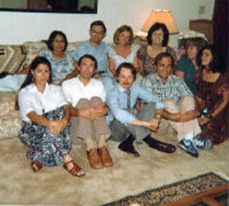
Notes:
Summer of 1981: at the home of Dan and Nancy Jordan with Bahá’í masters degree students studying at National University, Vista Campus, California. (This author took the photo) Front row, left to right: Janice Conyers, Jeff Kieley, Greg Watson, ?, ? Back row, left to right: ?, Dan Jordan, ?, Nancy Jordan, ? At this gathering Dan played a piece of classical music on the grand piano he had in his living room and then explained to us his plans for the development of the Anisa Model of Education.

Slide 24
Notes:
Summer of 1981: Dan Jordan sitting at the grand piano which he used to illustrate educational concepts. Standing: Jim Sacco, the co-founder and director of the School of Nations in Brasilia with a representative from the municipal government of Brasilia who is reading a greeting to the students and her hopes for the success of Anisa in Brasilia.

Slide 25
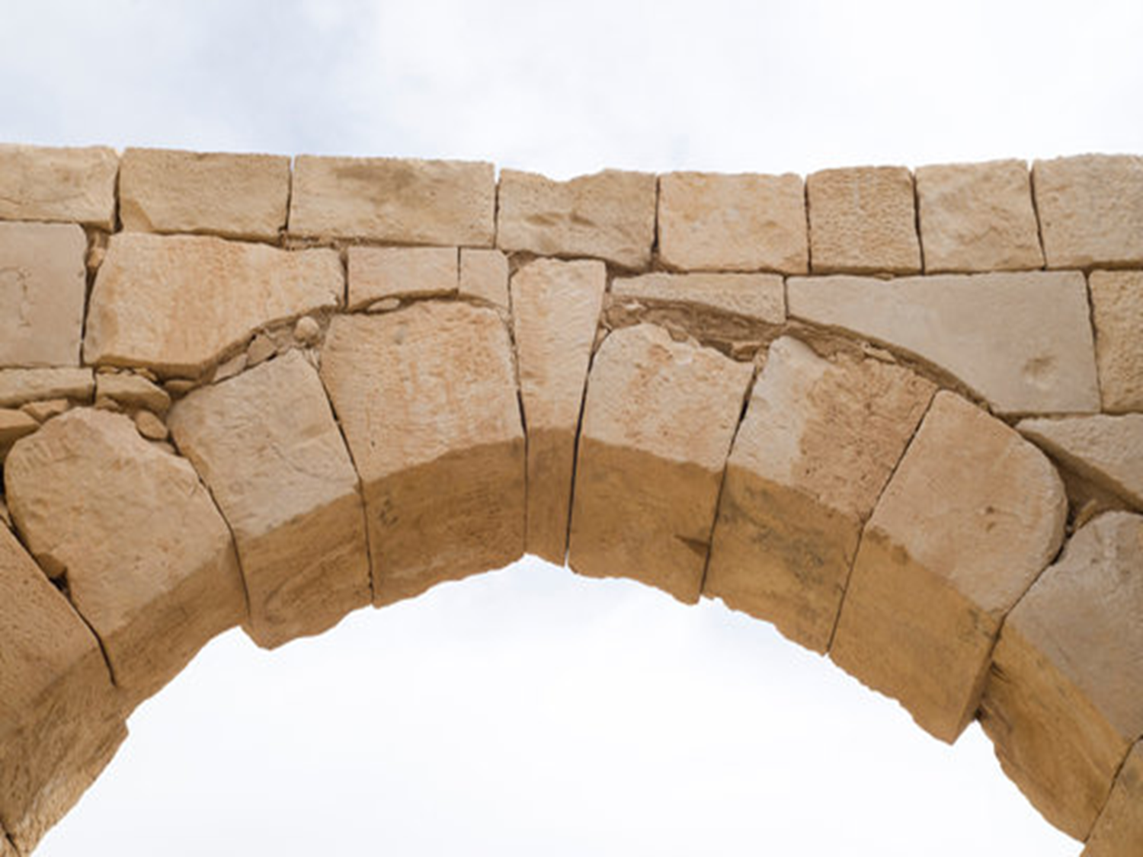
The organizing principle found by Dr. Jordan:
“Potentiality is translated into actuality via interaction with the environment.”
P → A
I c E
_

Slide 26
ANISA MODEL: MAJOR COMPONENTS
INTERCONNECTION BETWEEN THEORIES AND EVALUATION DATA
PHILOSOPHICAL BASIS
(View of Man)
THEORY OF DEVELOPMENT
THEORY OF ADMINISTRATION
THEORY OF CURRICULUM
THEORY OF PEDAGOGY
THEORY OF EVALUATION
Notes:
This diagram is from page 112 of George Bondra’s 1980 doctoral dissertation titled, “The Anisa Model: A Scientific Paradigm for Education and its Implications for a Theory of Evaluation.”

Slide 27
Notes:
List of philosophers and theoreticians that informed the creation and development of the Anisa Model. This is a copy of the original notes written by Dr. Jordan at the request of Irene Hartley.

Slide 28
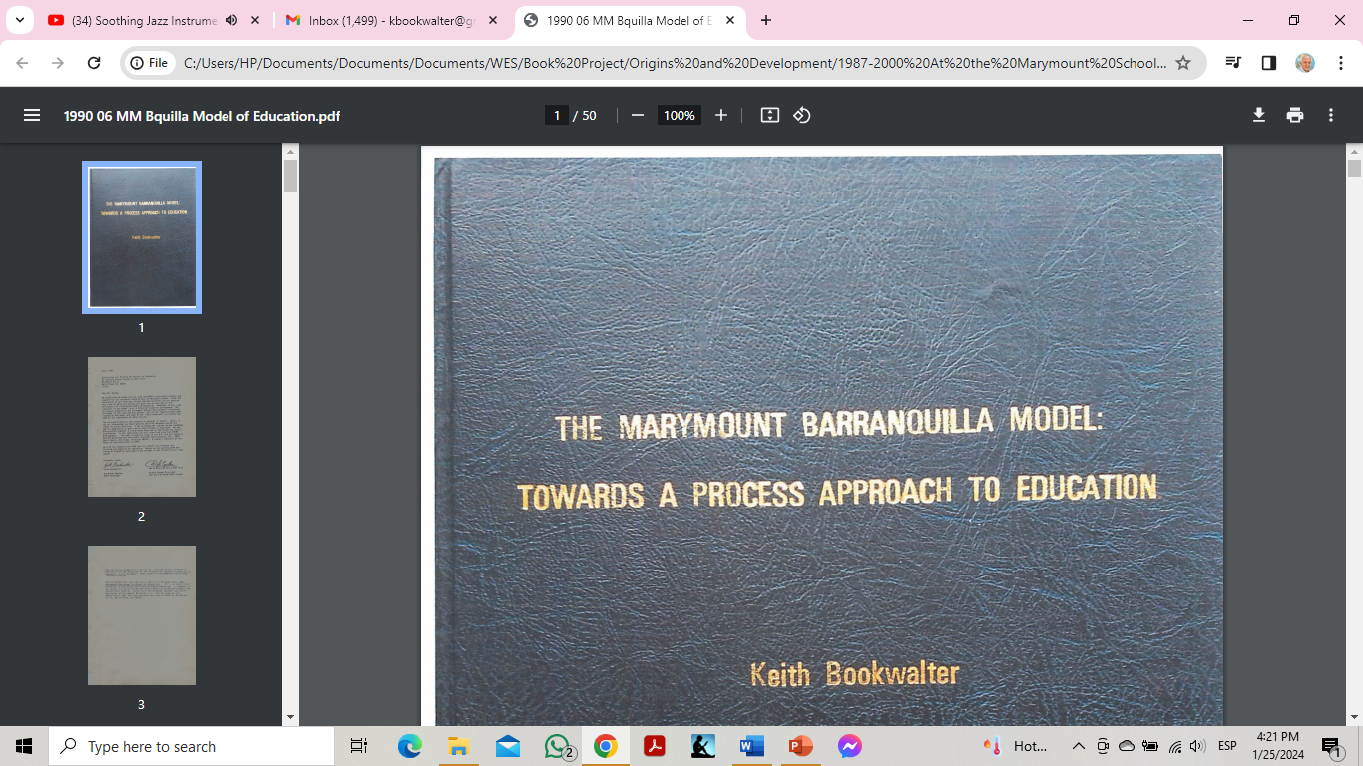
Notes:
June 1990: The Marymount Barranquilla Model, Colombia (1987-2000), 50 pages.
Dr. Malcolm D. Evans, the Executive Secretary of Association for Process Philosophy of Education and the former Superintendent of Schools at Suffield, Connecticut where the Anisa Model was first piloted, described it as “a significant blending of Christian faith and process education” and commended it to “anyone trying to think seriously about process philosophy and educational praxis.”

Slide 29
Notes:
1988: Keith Bookwalter welcoming Irene Hartley to Marymount School, Barranquilla, Colombia to begin a six-year collaboration in the implementation of the Anisa Model of Education which resulted in the creation of the Marymount-Barranquilla Model of Education.

Slide 30
Notes:
Circa 1990: Marymount School, Barranquilla, Colombia: left to right: Gordon Hartley, Irene Hartley, and Keith Bookwalter.

Slide 31
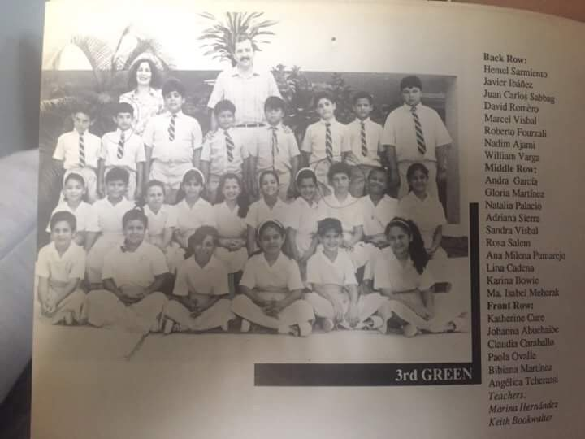
Notes:
This author’s 3rd grade class of 1989-1990 at Marymount School, Barranquilla, Colombia

Slide 32
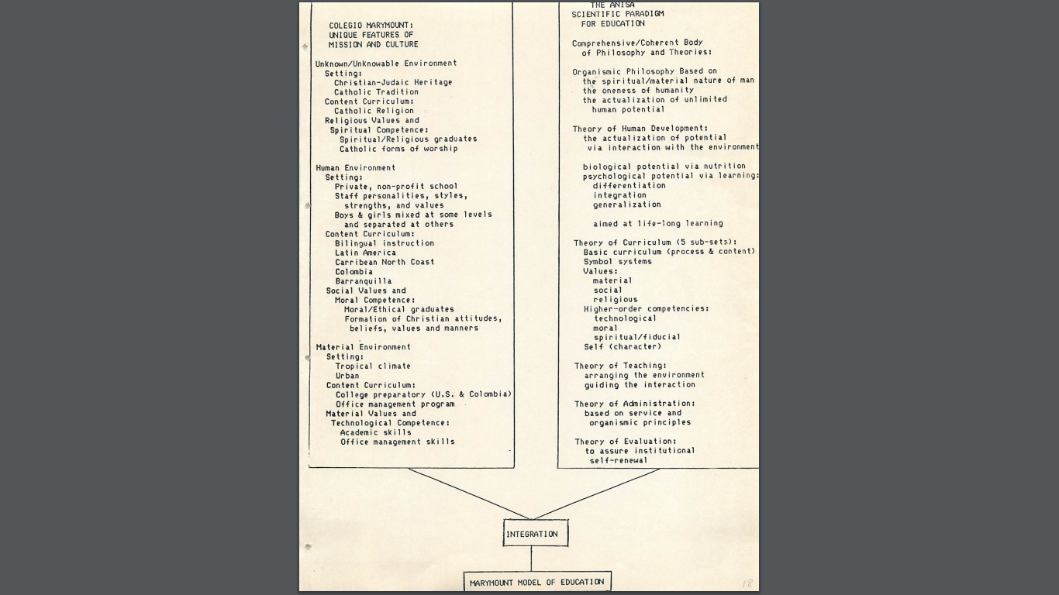
Notes:
This diagram shows the fusion of Marymount School’s culture and purposes with the Anisa Model’s philosophy and theories resulting in the creation of the Marymount-Barranquilla Model of Education which is set forth in the 50-page summary.

Slide 33
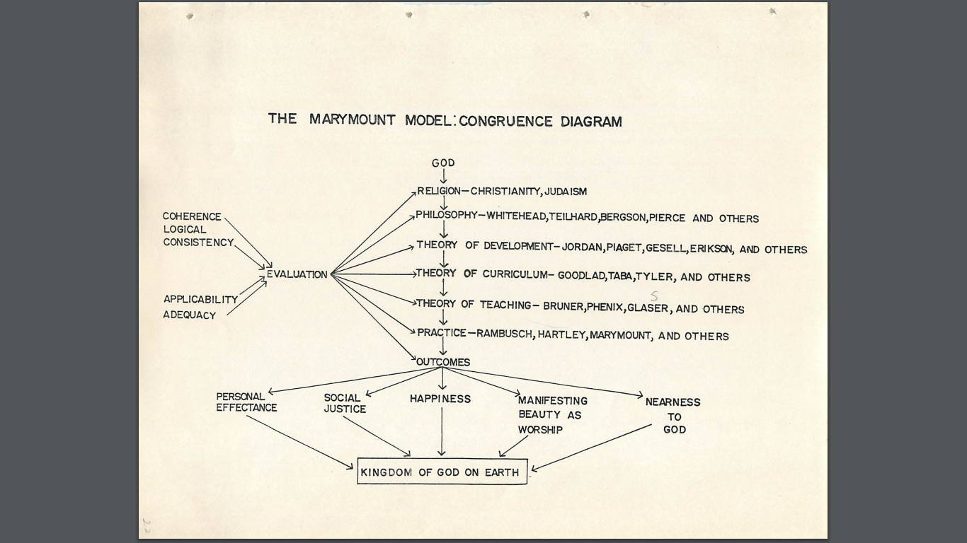
Notes:
This diagram shows how the Anisa Model provided Marymount with the means for coherently translating the Kingdom of God in heaven (a potentiality) into the Kingdom of God on Earth (an actuality) – in each person, home, classroom, and the school as a whole -- as promised in The Lord’s Prayer.

Slide 34
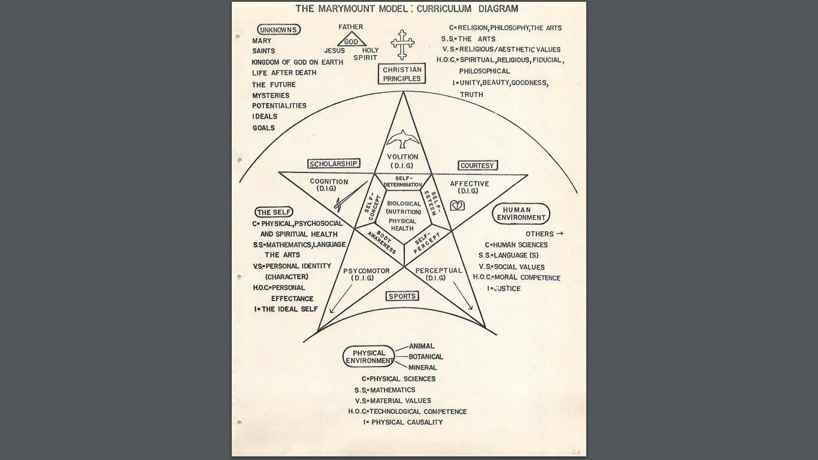
Notes:
This diagram represents the integration of Marymount curriculum and values with those of the Anisa Model.

Slide 35
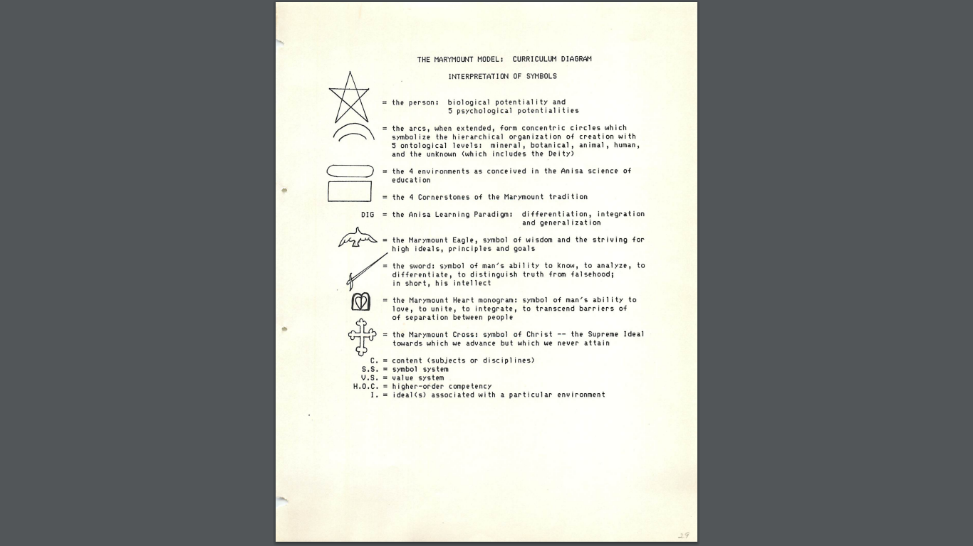
Notes:
This Marymount Model glossary presents the symbols used by Marymount School and their meaning in terms of the Anisa Model that it adopted.

Slide 36
Part 2:
The Development of Anisa as WES
(42 slides)
Notes:
Part 2 presents how The Wholistic Educational System was developed from the Anisa Model of Education based on this author’s experiences with learning it, delving into its roots, and implementing it in whole or in part at eight different schools.

Slide 37
Divine Guidance
The Arts &
Other Humanities
Philosophy
Sciences &
Related Fields
Educational
Philosophy
Theories of Development
Po→A← +p Pu/I -p →E
and Learning
Theory of Curriculum
Theory of Administration
and Learning Community-Environment
Relations
Theory of Teaching
Praxis
Theory of Evaluation
The Eleven Components of the Wholistic Educational System (WES)
Notes:
See the handout: “Explanation of the Major Components of WES”; which is the same as the following:
An Explanation of the “Major Components” Diagram of The Wholistic Education System
by William Keith Bookwalter
(Composed: 12/14/2014; Updated: 1/19/2024)
This diagram shows the eleven major components of The Wholistic Educational System (WES): the major fields that inform WES, the major subfields of education, and the relationships amongst them.
The fields that inform education are divine guidance, philosophy, science, the arts and other humanities, and, of course, all of the subfields of education.
The components of the field of education are: educational philosophy; educational theories of development, learning, curriculum, teaching, administration, institution-community relations, evaluation, and educational praxis.
Divine guidance is the guidance received from spiritual sources: the Creator, His Messengers, the Holy Spirit, souls in this world (including one’s own soul), and souls in other spiritual realms. The means for receiving divine guidance include, but are not limited to, the study of the sacred scriptures of the world religions, prayer, meditation, contemplation, insights, intuition, visions, dreams, day dreams, and serendipitously being led to particular people, books, conversations, consultations, and other experiences which, in turn, provide solutions to problems and answers to questions regarding one’s understanding, implementation, and development of the Wholistic Educational System.
Philosophy--humanity’s thinking about humanity and the reality of which humanity is but a part --has been a major contributor to Anisa and WES. The Anisa team reviewed the major philosophies of the world covering over 2,000 years of recorded thought, and arrived at Alfred North Whitehead’s process / organismic / speculative philosophy or cosmology that was considered to be the most comprehensive and the one that best harmonized Eastern and Western thinking. In my opinion, it also harmonizes Native American thinking with Eastern and Western thought. According to Whitehead, his cosmology is actually closer to Far Eastern philosophies:
The philosophy of organism seems to approximate more to some strains of Indian or Chinese thought than to western Asiatic or European thought. (Process and Reality, p7)
There are other process philosophers of great importance. For example, Malcolm Evans’ Association for the Process Philosophy of Education (APPE) also focused on the works of John Dewey and Henri Bergson. Charles Pierce and Charles Hartshorne are also important process philosophers. (See Hartshorne’s comment on Whitehead on slide 15 in the attached PowerPoint presentation on WES. See slides 18 and 19 for examples of fields that have been influenced by Whitehead.)
The fields of science that inform the Wholistic Education System are many. They include human development, sociology, developmental psychology, neurology, nutrition, technology, communication, information systems, and many more, including the fields of architecture and engineering as they apply to the design of physical plants for schools and universities, learning environments and didactic materials and equipment. One of the problems with science, especially brain research, is that it is currently experiencing such a “boom” of output that educators are finding it difficult to learn about the multitude of research findings and apply them to teaching. Hence, a WES-oriented institution or institutions are needed to process all of the research findings and run them through the educational philosophy and the other components of the System, thereby organizing them and making them more “digestible,” understandable, and applicable for educational practitioners.
The arts and other humanities may seem, at first, to contribute little, other than subject matter, to the development of the field of education. But, as C.P. Snow stated in The Two Cultures, “Great literature reveals aspects of humanity that science ignores and formal religion distorts.” Jean Jacque Rousseau’s novel Emile, for example, was the most influential book in Western Civilization on education since Plato’s Republic. And, closer to the development of the Anisa Model, Dr. Jordan would combine his lectures with playing a grand piano in front of the class in his lecture hall at National University in order to illumine and give examples from music of the fundamental principles underlying its philosophy and theories.
The top-to-bottom arrows in the diagram indicate lines of deductive generation of the system components. Bottom-to-top arrows originating from praxis and evaluation indicate lines of inductive development of WES, thereby assuring its perpetual renewal. (In practice, bottom-to-top arrows extend to all components because all components are continually evaluated. For the sake of visual clarity, however, this was not done.) It should be noted that the evaluation of divine guidance as it is given to humanity via the great, revealed, world religions, does not mean the evaluation of the Creator’s Revelations, but, rather, the continual reconsideration of our understanding of the revealed Word and its implications for education, the results of which will evolve from one generation to another.

Slide 38
Complete Alignment of the Eleven Components of WES:
Divine Guidance
↓
The Arts (and other Humanities)
↓
Process Philosophy
↓
Science
↓
Philosophy of Education
↓
Theories of Development & Learning
↓
Theory of Curriculum
↓
Theory of Teaching
↓
Theory of Administration &
Learning Community-Environment Relations
↓
Praxis
↓
Theory of Evaluation
Notes:
Although oversimplified and not meant to show a chronological sequence, the diagram does show some priorities and foundations and the need for coherent, total, comprehensive alignment amongst the eleven components of the system. Divine guidance is the most fundamental and important component. All other components must be in harmony with it. The philosophy of education was derived from divine guidance, the arts and other humanities, especially process philosophy, and science. The theories were derived from and are coherent with the philosophy of education. Praxis, in turn, is derived from and needs to be coherent with the theories, especially the first principle of the theory of development.

Slide 39
WES is informed and inspired by the revealed “Divine Guidance” found in the sacred scriptures and oral traditions of the world which illumine, for example:
- how to practice the presence of God
- the nature of reality,
- the purpose of life, and
- how to increase happiness.
Notes:
Some examples of sources of divine guidance follow.
Although religion, as a source of knowledge, inspiration, and daily religious practices has been greatly discredited, especially in Western civilization, science now provides a “back door” to spirituality via neuroscience. See, for example, The Awakened Brain: The New Science of Spirituality and Our Quest for an Inspired Life by Dr. Lisa Miller, founder of the Spirituality Mind Body Institute, Teachers College, Columbia University.

Slide 40
Some examples of sources of Divine Guidance
(in chronological order from most recent to most ancient):
1844: Bahá’í Faith:
- Kitáb-i-Aqdas and 100+ other books revealed by Bahá’u’lláh (6,000,000 words)
- The Bayán and other works revealed by The Báb (5,000,000 words)
622: Islam: Qur'án (77,430 words)
1 A.D.: Christianity: Gospel (New Testament; 181,253 words)
580 B.C.: Buddhism: Tripitakas (2,708,706 words)
c. 560 B.C.: Taoism: Tao Te Ching (19,500 words)
1000 B.C.: Zoroastrianism: Avesta (83,000 words)
1330 B.C.: Judaism: Torah (Old Testament; 503,493 words)
2-3000 B.C.: Hinduism: The Vedas that include The Upanishads (64,500 words); Bhagavad Gita (9,839 words)
3000 B.C. (peak of population): Inspired Native American Indian Teachings
And others that WES will continue to draw upon
Notes:
These examples appear in chronological order from the most recent to the most ancient.
“According to some estimates, there are roughly 4,200 religions, churches, denominations, religious bodies, faith groups, tribes, cultures, movements, ultimate concerns, etc.” https://en.wikipedia.org/wiki/List_of_religions_and_spiritual_traditions
Hence, insights gained from them and input to WES and its practice is an ongoing process.
Because of the large volume of writings regarding education in the Bahá’í’ Faith and their recentness, WES has drawn most heavily from this source.
The capital letters “D” and “G” in Divine Guidance denote the greater “directness” of the guidance from the Creator through special Personages referred to as divinely inspired Messengers, Major and Minor Prophets, Manifestations, Visionaries, Seers and other terms.

Slide 41
WES is also informed by “divine guidance” given to persons and groups who are seeking inspiration, solutions to problems, or for other needs. The Creator, in response to earnest prayer, sincere searching, and deep yearning can inspire, for example:
- Thoughts
- Meditations
- Day dreams
- Night time dreams
- Conversations
- Consultations
- And other everyday events.
Notes:
The lower case “d” and “g” in “divine guidance” denotes the minor, “everyday” means of accessing divine guidance.
There are many histories of “aha! moments” experienced via these means. The Bahá’í scriptures state that there are angels in heaven that inspire people on earth with ideas for advancing the arts and the sciences. (The Greeks and Romans believed in the nine goddess muses.) Of course, the next step after receiving guidance is to take it to the “laboratory” for scientific testing.
Irene Hartley, one of the major “translators” of Anisa theory into classroom practice and director of the Anisa laboratory school at National University in San Diego, California, told me that many of her “inspirations” came to her during her morning showers!

Slide 42
Eight Religious / Spiritual Notions Undergirding WES
The following are ever present in the mind of a WES educator:
There is one Creator Who is referred to by various names and titles.
Every created thing has been endowed with and can manifest the names and attributes of God. Humans can show forth all of them.
Humankind is one, organically-interrelated race; one human family.
Notes:
In order to create a logically consistent link between religion and WES's process philosophy (summarized below), the statements above need to be viewed from a process perspective which views the nature of reality as the continual actualization of potentiality into actuality (Wheatley, 1994). Reflecting the image of God in one's life, i.e., manifesting His/Her attributes, is a God-given, personal potentiality which is actualized through such processes as the acquisition of knowledge, love, prayer, meditation, and service to humankind. The Kingdom of the Father on earth is a social potentiality. When it is actualized through collective processes and enterprises, divine attributes such as justice, unity, and peace will be reflected in human affairs at all levels of society, including the family, classroom, school, neighborhood, and community.

Slide 43
The manifold purposes of human life include:
  4. to know, love, and worship the Creator through interacting with
  His/Her revealed Word and through interacting with and
  serving His/Her creation;
  5. to become the image of God by acquiring His/Her attributes
  and virtues;
  6. to build the Kingdom of the Father on earth by carrying forward
  an ever-advancing civilization and by building a new world
  order;
  to prepare one's soul for life beyond death.
  The Creator renews His eternal Faith approximately every thousand years by sending an Intermediary Who reveals laws and establishes a new religion, which, in turn, stimulates the flowering of a new civilization.

Slide 44
Sciences that inform WES
Physical Sciences
  Physics
  Chemistry
Life Sciences
  Biochemistry
  Genetics
  Nutrition
  Neuroscience
  Psychology
  Human development and learning
  Ecology
Social Sciences
  Administration
  Anthropology
  Communication
  Education
  Linguistics
  Sociology
Formal Sciences
  Logic
  Epistemology
  Systems Theory
Applied Sciences
  Architecture
  Engineering
  Technology
Notes:
Daniel Jordan, like John Dewey before him, founded a laboratory school in a university setting. For WES to be developed in future, such a university setting will be needed in order to have close contact and input from experts in these and other fields. Of course, the Internet facilitates the possibilities of expanded collaboration from around the globe.

Slide 45
Five scientific tenets that guide the development of WES
The Wholistic Educational System fulfills the qualifications of a science, is scientific in its method, and upholds the following science-related tenets:

Slide 46
1. Creation being hierarchically organized and humankind being at the apex of all created things (with the exception of the Prophets during their lifetime on earth), human reality can be viewed as a composite of all lower ontological levels; containing all of the powers of the material, botanical, and zoological realms; while also manifesting human and divine attributes which are not possessed by beings at the lower levels. Hence, humankind can be viewed as the "book of creation." Paradoxically, the universe, which contains human beings, in a sense, is also contained within human beings.
Notes:
The most unique characteristic of human beings is their possession of a soul. Special human powers include mathematics, sophisticated language structures and symbol systems, extensive collective memory (history), the ability to choose their role in society, and long-range planning abilities.
Special spiritual powers include the ability to pray, to worship, and to dream of events before they occur (déjà vu).

Slide 47
Spiritual, Divine Nature
Psychological Nature
(higher emotions, intellect, & volition)
Social Nature
Animal Nature
Organic Nature
Inorganic Nature
Electrical, Magnetic, and
Sub-atomic Nature
The Manifold, Hierarchically-Organized Nature of Human Beings
Notes:
Reality is organized hierachically. We are just a tiny part of the universe but we also contain all aspects of the universe.

Slide 48
2. Because a human being can be understood as “the book of creation," all of the sciences--physical, social, psychological and spiritual--effect directly or indirectly human life and, consequently, the educational process.

Slide 49
PHYSICAL and BIOLOGICAL
SCIENCES
SOCIAL SCIENCES
PSYCHOLOGICAL SCIENCES
SPIRITUAL SCIENCES
SCIENCE OF THE SELF
HIERARCHICAL ORDERING OF SCIENCES
Notes:
This Whiteheadian concept – that reality is organized hierarchically -- requires even a quark (placed in the inner circle) to “belong” to its own ontological level and to the higher-order environments by having a “life” that is not only physical but also social, psychological, and spiritual in nature. A quark behaves as a material entity but it cannot exist in isolation from its “social” environment of other material entities. Physicists have attributed even to a quark a tiny amount of self-determination and choice rendering its behavior “not always predictable” and thereby recognizing the “mental” or “psychological” aspect of its nature. In my opinion, anything created by the Creator has, at least, a “spark” of the Creator; a spiritual aspect of its nature. Just as a drop of water proceeding from the ocean contains attributes of the ocean, so does even a quark manifest one or more attributes of its Creator. The Creator also has all of these aspects of reality. A Creator without a material creation is unimaginable, just as a king without a kingdom makes no sense. The Creator is also “social” in relation to His creatures – caring for them, answering their prayers, verbalized or not, etc. And He certainly has a “psychological” nature full of feelings, thoughts, purposes, and plans as revealed via His/Her Prophets. His distinctive, spiritual nature is ultimately unknowable, unfathomable, invisible, transcendent. For lack of a better way to diagram the environment of “the self” of the learner, and with no intention of showing disrespect to the All-Comprehensive Creator, I placed the Environment of the Self in the outer sphere. Human beings are at the peak of the pyramid of creation (with the exception of the Manifestations of God and ‘Abdu’l-Bahá during the time that They walked the earth). We are “contained” in the universe and we also “contain” the universe. Our body is composed of minerals. For digestion, we depend on the millions of bacteria from the plant kingdom. We also manifest the vegetable powers of growth and reproduction. We have an animal aspect of our nature expressed through the senses, ingestion of food, and the sex impulse. At our distinctively human, ontological level, we have a rich mental and spiritual life with powers that distinguish us from the animal kingdom such as complex language, writing, complex thought, collective memory, the ability to become a craftsperson or professional of our own choice and to play that role in human society, and the capacity to be the “image of God” by manifesting all of Her/His names and attributes in our lives.

Slide 50
3. All of the sciences (e.g., organic chemistry, genetics, neurology, anthropology, sociology, and psychology) confirm the principle of the organic oneness of the human race. This supports the possibility of creating a universal system of education which will take into account both the unity and the diversity of humankind.
Notes:
That is, educational curricula, depending on the place of the educational institution, needs to be a combination of objectives that are universal, cultural, national, regional, and local in nature.

Slide 51


Slide 52
4. All of these same sciences confirm the principle of the basic equality of men and women as regards intellectual capacity and the potentiality of women, when given equal educational and vocational opportunities, to make significant contributions in virtually all fields of human endeavor.
Notes:
Iceland is the first country in the world to legalize equal pay between men and women.

Slide 53


Slide 54
5. The roles of science in the advancement of civilization:
  the translation of potential knowledge into actualized knowledge, i.e., the production of knowledge, via various modes of knowing, such as: intuition, inspiration, dreams, prayer, meditation, experience, logic, scholarship, and systematic research;
  the organization of knowledge into coherent, logically consistent systems for future acquisition of knowledge by others
  the application and dissemination of knowledge for the highest good of all things everywhere.
Notes:
“Acquistion of knowledge” is actually a preliminary step for scientists and learners. “Activating background knowledge” is part of the thinking and learning process which depend on activatiting working memory and long-term memory. A portion of the collective memory of the human race can be accessed and acquired via conducting research reviews, carrying out an Internet search, or consulting AI via, for example, ChatGPT 3.5 or 4.0.

Slide 55
Assimilates
Acquires
Develops
Forms
Builds
Symbol
attached
to meaningful
experience
Knowledge
Competency
Skill
Concept formed
(Classification)
Competency (skill) acquired
Generalizes
Transfers
Utilizes
The learner applies concept
The learner constructs concept
Experiences with
2-dimensional representations,
illustrations, pictorials
Knowledge
Competency
Skill
3-dimensional, life-like, virtual reality experiences
Experiential Base: Real life / Real world experiences
Richer perceptual, emotional and motor memories
Richer immanence to draw upon
Notes:
This diagram symbolizes the processes of acquiring and applying knowledge for both learners and scientists (who are basically “professional learners.” When they publish their research results, they are exclaiming, in a way, “Look what we have learned!” When planning and carrying out a learning experience or unit, the teacher should make every effort to provide a rich, hands-on, experiential base shown at the bottom of this pyramid and then move upward towards the abstract level of symbols. (Keep in mind that reality has two forms actual and non-actual. Hence, dreams can also be considered “real world experiences.” Its just that, at this point of our evolution, there is no assured way of “arranging dream experiences” for learners.) Too often, we educators rush too quickly to symbols–reading, writing, and mathematics especially–because the symbolic level is where students are required to demonstrate their knowledge and skills on achievement tests. The downward, righthand arrow is also important because once knowledge or skills are acquired, in order for them to be deeply learned and useful, they must be applied to a similar and then increasingly different, real-life or simulated situation that is relevant to the learner.

Slide 56
Symbolic:
lectures,
discussions, text,
Wikipedia, words,
numbers & symbols
Grounded learning & acquisition of ideas, concepts, competencies, skills, etc.
Application of learning, ideas, concepts, competencies, and skills, etc.
2D: videos, DVD’s, slides,
computer simulations, pictures,
base-10 pictures, maps, diagrams, etc.
3D: models of solar system, molecules, etc., manipulatives, base 10 blocks, relief maps, simulations, role playing, virtual reality videos and others
Real Life: field trips, cooking, making, creating, building, publishing, photography, laboratories, community service, solving real problems, etc.
Notes:
This diagram offers more concrete, educational examples of the categories shown in the previous diagram. I often provide these as handouts which I encourage teachers to store, and preferably display, at the place where they do their unit planning. Needless to say, providing rich, real life, learning experiences requires a great deal of effort in the mobilization of resources: places to visit, objects or people to bring into the classroom, time in the calendar, human resource support, finances, etc.

Slide 57
Humanities that inform and illumine WES
Philosophy
  Process Philosophy
  Speculative Philosophy
  Metaphysics
History
  History of science
  History of education
  History of curriculum
Religious studies
Literature
  Novels, e.g., Émile
  Poetry
Performing Arts
  Music
  Theater
  Dance
Visual Arts
  Drawing
  Painting
  Sculpture
  Film
Notes:
Examples and possibilities of each need to be documented and included in teacher training programs. That is, teachers in pre-service and in-service training should interact with not only textbooks that review research, but also all of the various forms of the humanities in order to enhance all of the phases of their “rhythm of learning”: romance, precision, and generalization. (These are explained later.)

Slide 58
Principles regarding the arts and other humanities that inform WES
The arts and other humanities comprise an inexhaustible body of culture-based knowledge that have illumined and can continue to illumine our understanding of human life, the very subject and object of education. Hence, relevant, illuminating and inspiring music, novels, poetry, film, songs, other arts and other humanities are drawn upon in the training of educators in WES.

Slide 59
As stated by C.P. Snow in his famous essay “The Two Cultures” that laments the modern divide of science and the humanities:
“Great literature reveals aspects of humanity that science ignores and formal religion distorts.”
Notes:
I would expand this statement to include the other arts, i.e., all the “great” music, poetry, architecture, sculpture, painting, dance, and film.

Slide 60
And, according to Albert Einstein:
“[A person] must learn to understand the motives of human beings, their illusions, and their sufferings in order to acquire a proper relationship to individual fellow-men and to the community . . . These precious things are conveyed to the younger generation through personal contact with those who teach, not—or at least not in the main—through textbooks. It is this that primarily constitutes and preserves culture. This is what I have in mind when I recommend the “humanities” as important, not just dry specialized knowledge in the fields of history and philosophy.”

Slide 61
Immanence
Transcendence
Present
Hi
Hi
Hi
Lo
Lo
Lo
Past events (+ -)
Mindfuiness
Future
Accomplishments
Plans
Traumas
Blessings
Goals
Exectations
Acquisitions
Dreams
Self
Short / Mid / Long range
Family
Mission / Vision
Subjective Aims
Final Causes
People
Nation
The arts and the humanities illumine our understanding
of our past, present, and future.
Notes:
This was the diagram that I presented at a conference in Hangzhou, China in 2018 on Whitehead’s process philosophy. I discussed how I was applying this concept to the education of a student body composed mainly of Mexican migrant students in East Palo Alto, California at that time. I explained how this same concept applied to China’s continuing recovery and renewed cherishing of its religious and philosophical roots, i.e., its immanence, while projecting its vision of itself into the future, i.e., its transcendence. I am having the basic elements of this diagram turned into a digital slide to add later to the PPT along with explanatory notes. It is one of the fundamental, organismic concepts that will help transform education. This diagram would be one of the “anchor charts” on display in the teachers’ rooms of WESian schools in order to facilitate ongoing discussion and consultation.
This slide illustrates the Whiteheadian concepts of “immanence” and “transcendence” which, I believe, are of special importance for the development of individuals, families, ethnic groups, races, societies, cultures, and the human race as a whole. Briefly, “immanence” refers to all past events, experiences, and accumulated knowledge and material entities. Transcendence refers to the future, i.e., intentions, plans, goals, and visions of possibilities, in short, the realm of potentiality. Whitehead emphasizes that the “present moment” is the only element of time that actually exists. That is, the past is over with and the future is yet to occur. Nevertheless, the quality of the present moment is colored and deeply impacted by one’s immanence and by one’s transcendence. The challenge for and task of educators is then threefold: (1) to enable students to understand, have great pride in, and build on the strengths of their immanence, that is, their personal past, their family’s past (including their accumulated, material wealth), their people’s and nation’s history, and that of the human race – as the foundation and springboard for enabling them to (2) visualize inspiring future possibilities; and, thereby, enabling them (3) to make the necessary sacrifices for engaging in the current educational curriculum which will enable them to translate future possibilities into achievements.

Slide 62
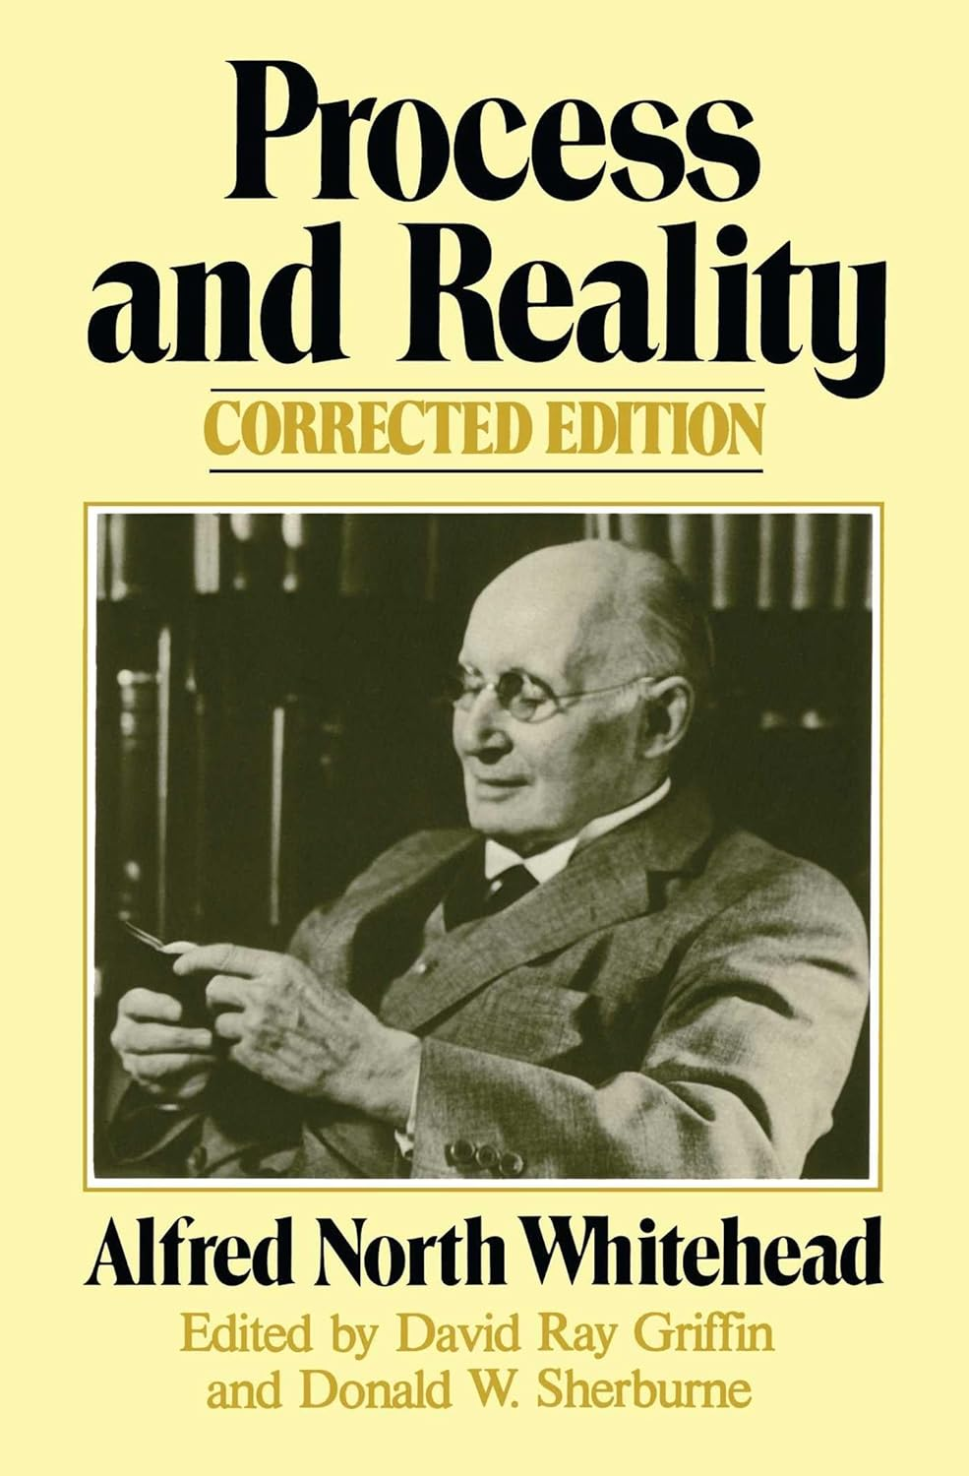
Notes:
First published in 1929. Corrected edition: 1978.

Slide 63
Speculative Philosophy is the endeavour to frame a coherent, logical, necessary system of general ideas in terms of which every element of our experience can be interpreted. By this notion of ‘interpretation’ I mean that everything of which we are conscious, as enjoyed, perceived, willed, or thought, shall have the character of a particular instance of the general scheme. --Alfred North Whitehead
Process and Reality (Gifford Lectures Delivered in the University of Edinburgh During the Session 1927-28) (p. 3). Free Press. Kindle Edition.

Slide 64
Alfred North Whitehead (1861-1947)
His major works
Principia Mathematica -- 3 volumes (1910-1913)
The Concept of Nature (1920)
Science and the Modern World (1925)
Aims of Education (1929)
Process and Reality (1929)
Adventures of Ideas (1933)
Modes of Thought (1938)
Notes:
Principia Mathematica was written with Bertrand Russell and was so cutting edge that it was difficult to find a group of mathematicians capable of reviewing it.
Process and Reality is Whitehead’s principle work. It is extremely challenging to read but the scheme of thought once understood is life-changing. Dr. Evans described his long discussions with Dr. Jordan in which the latter introduced Whitehead’s philosophy to him as a “watershed moment” in his life and career.
The other titles are very accessible and most enjoyable.
My doctoral faculty advisor, Dr. Mary Sheerin, required all of her doctoral students to read the first four chapters of Aims of Education.

Slide 65
Some of the principal process philosophers
Alfred North Whitehead
Henri Bergson
Charles Peirce
John Dewey
Charles Hartshorne
John B. Cobb Jr.
Notes:
Bergson, a French-Jewish philosopher, is “known for his arguments that processes of immediate experience and intuition are more significant than abstract rationalism and science for understanding reality.” --Wikipedia
Peirce is considered to be the “father of pragmatism” which holds “that most philosophical topics—such as the nature of knowledge, language, concepts, meaning, belief, and science—are all best viewed in terms of their practical uses and successes.” His metaphysics views evolution as “tending toward an end or goal, and it could also be the evolution of a mind or a society.” –Wikipedia
Dewey was a proponent of pragmatism. In his “naturalistic’ view, “inquiry should not be understood as consisting of a mind passively observing the world and drawing from this ideas that if true correspond to reality, but rather as a process which initiates with a check or obstacle to successful human action, proceeds to active manipulation of the environment to test hypotheses, and issues in a re-adaptation of organism to environment that allows once again for human action to proceed.” (from: Internet Encyclopedia of Philosophy) His application of this view to education is in harmony with WES.
Hartshorne was one of the founders of Process Theology and Whitehead’s assistant during his most productive years in the field of metaphysics. –Internet Encyclopedia of Philosophy. When Dr. Evans asked him which of Whitehead’s concepts he thought would be of most benefit to the field of education, Dr. Hartshorne’s response was, “prehension.”
Cobb is an American theologian, philosopher, and environmentalist. He is often regarded as the preeminent scholar in the field of process philosophy and process theology, the school of thought associated with the philosophy of Alfred North Whitehead. (We were fellow members of APPE. Via this association, Dr. Cobb invited me to present a paper at a conference on Whitehead in India in 2009. At the age of 98 [in 2024] he is still with us and is pleased with the existence of Anisa as an application of Whitehead’s cosmology to education.)
Note: Another source of both spiritual and philosophical orientation for WES has been the work of Nikos Kazantzakis, especially his Report to Greco and The Saviors of God.

Slide 66
Educators who have recommended
Whitehead’s cosmology for the field of education and/or actually applied it
Robert Brumbaugh, Yale University
Charles Hartshorne, University of Texas
Daniel C. Jordan, UMass & National University
Malcolm Evans, founder of the Association for Process Philosophy of Education
Donald W. Oliver, Harvard University
Notes:
Robert S. Brumbaugh was a philosopher and professor at Yale University. He is the author of Whitehead, Process Philosophy & Education. I corresponded with him. He encouraged me to continue my application of process philosophy to education.
As I mentioned above, Charles Hartshorne, during an interview with Malcolm Evans, said that one of the most important Whiteheadian concepts for education is “prehension.”
Daniel C. Jordan was the Dean of the School of Education at National University and the creator of the Anisa Model of Education.
Malcolm Evans was the superintendent of the Suffield, Connecticut public school system when he invited Dr. Jordan to implement the Anisa Model at one of its schools. He later founded the Association for Process Philosophy of Education (APPE) and wrote Whitehead and Philosophy of Education. He was a member of my doctoral committee. He published an article I wrote on WES in APPE’s Process Papers. Shortly before his passing, he edited and commended my paper, “The Wholistic Educational System: First Principles and Corollary Principles.”
Donald W. Oliver is a professor at Harvard University and the author, with Kathleen Gershman, of Education, Modernity, and Fractured Meaning: Toward a Process Theory of Teaching and Learning.

Slide 67
Charles Hartshorne on Alfred North Whitehead’s
Philosophy of Organism / Metaphysics / Cosmology /
Process Philosophy
“In conclusion, one may say that the basic principles of our knowledge and experience – physical, biological, sociological, aesthetic, religious – are in this philosophy given an intellectual integration such as only a thousand or ten thousand years of further reflection and inquiry seem likely to exhaust or adequately evaluate, but whose wide relevance and in many respects at least comparative accuracy some of us think can already be discerned.”
Notes:
In Whitehead’s Philosophy: Selected Essays, 1935-1970; Lincoln: University of Nebraska Press, 1972, p. 19
The philosophy of education of WES, in its current iteration, was generated mainly from the teachings of Bahá’u’lláh and the process philosophy of Alfred North Whitehead.
A philosophy of education “examines the goals, forms, methods, and meaning of education.” (Wikipedia) It acts as a step-down transformer from philosophy’s integration of divine guidance, the arts and other humanities, and science to “applied philosophy” in the field of education.

Slide 68
7th International Whitehead Conference
January 5-9, 2009
Bangalore, Karnataka, India
Process, Religion and Society
“The philosophy of organism seems to approximate more to some strains of Indian or Chinese thought than to western
Asiatic or European thought.” (Alfred North Whitehead, Process and Reality, 7)
Call for Papers
Everybody who can identify with one or other objective of this conference is cordially invited to attend and present a paper at the 7th International Whitehead Conference.
Organized By
Faculty of Philosophy
Dharmaram Vidya Kshetram www.dvk.in
PG Department of Philosophy
Christ College (Autonomous) www.christcollege.edu
Notes:
Although I was not able to attend, I was invited by Dr. John B. Cobb Jr., a fellow member of the Association for Process Philosophy of Education, to participate in this conference in order to present my application of Whitehead’s process philosophy in the field of education. This and the next three slides are from that invitation showing the topics of other presenters. I was amazed with the multiplicity of connections with such a wide variety of leaders of thought and applications to so many other fields of human endeavor.

Slide 69
1. Whitehead and Process
Aurobindo Ghosh
Nicolas Berdyaev
Buddhists
Pre-Socratists
Charles Darwin
Ramanuja
Charles Hartshorne
Samuel Alexander
Charles Peirce
Tagore and Gandhi
Existentialists
Taoists
Georg W. F. Hegel
Teilhard de Chardin
Henri Bergson
William James
John Cobb Jr.
Yin-Yang
John Dewey
Mohammed Iqbal
Any other
Notes:
Some of these names you will probably recognize. Others, like me, you may never have heard of before. For the “Any other” category, I would have added Robert Brumbaugh, Daniel C. Jordan, and Malcolm D. Evans. What names would you add?

Slide 70
2. Whitehead and Religion
Atheism
Religion and Evolution
Evil and Suffering
Religious Art
Fundamentalism
Religious Cults and Sects
God
Religious Mysticism
Hindutva
Religious Violence and Holy War
Indian Religions
Science and Technology
Morality/Ethics
Spirituality
New Religious Movements
Women/Feminism
Politics and State Power
Any other
Notes:
For the “Any other” category I would have added, “The Bahá’í Faith.” Roger Coe, a fellow Anisa colleague, would probably add, “The I Ching” due to his deep appreciation and knowledge of this sacred book of the East.

Slide 71
3. Whitehead and Society
Business Ethics
Human Rights
Child Labour
Illiteracy vs. Literacy
Common Good
Immigration
Development
Nationalism
Ecology
Nuclear Proliferation
Economics
Poverty and Famine
Education
Social Justice
Notes:
I would have added, “Gaia,” “Planetary Unity,” “International Justice,” and “World Peace,” that is, seeing the planet and the human race as independent yet interrelated entities subject to the same principles set forth in Whitehead´s philosophy of organism.

Slide 72
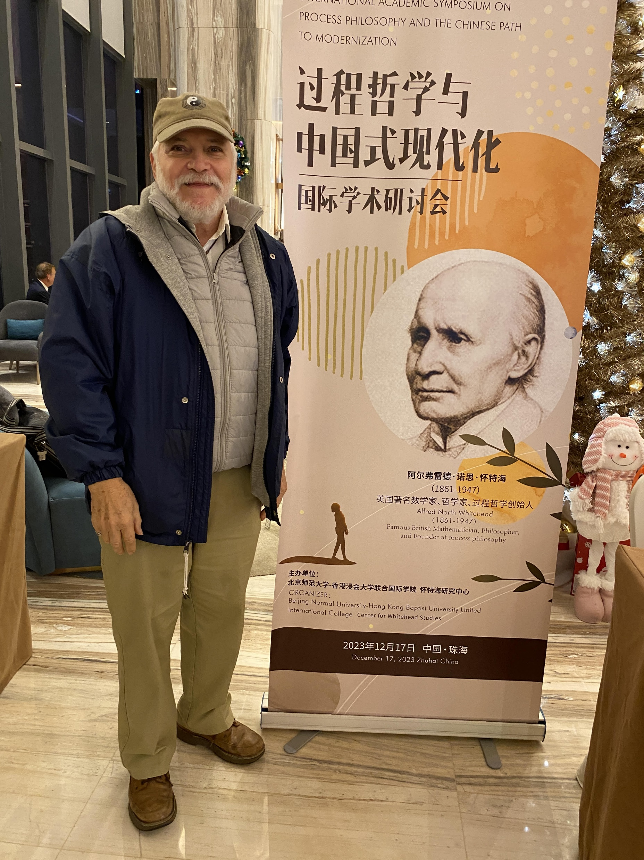
Notes:
Roger Coe, Bahá’í, expert in the Anisa Model of Education, process philosophy, and the I Ching, attending the “International Academic Symposium on Process Philosophy and the Chinese Path to Modernization,” December 17, 2023, Zhuhai, China.

Slide 73
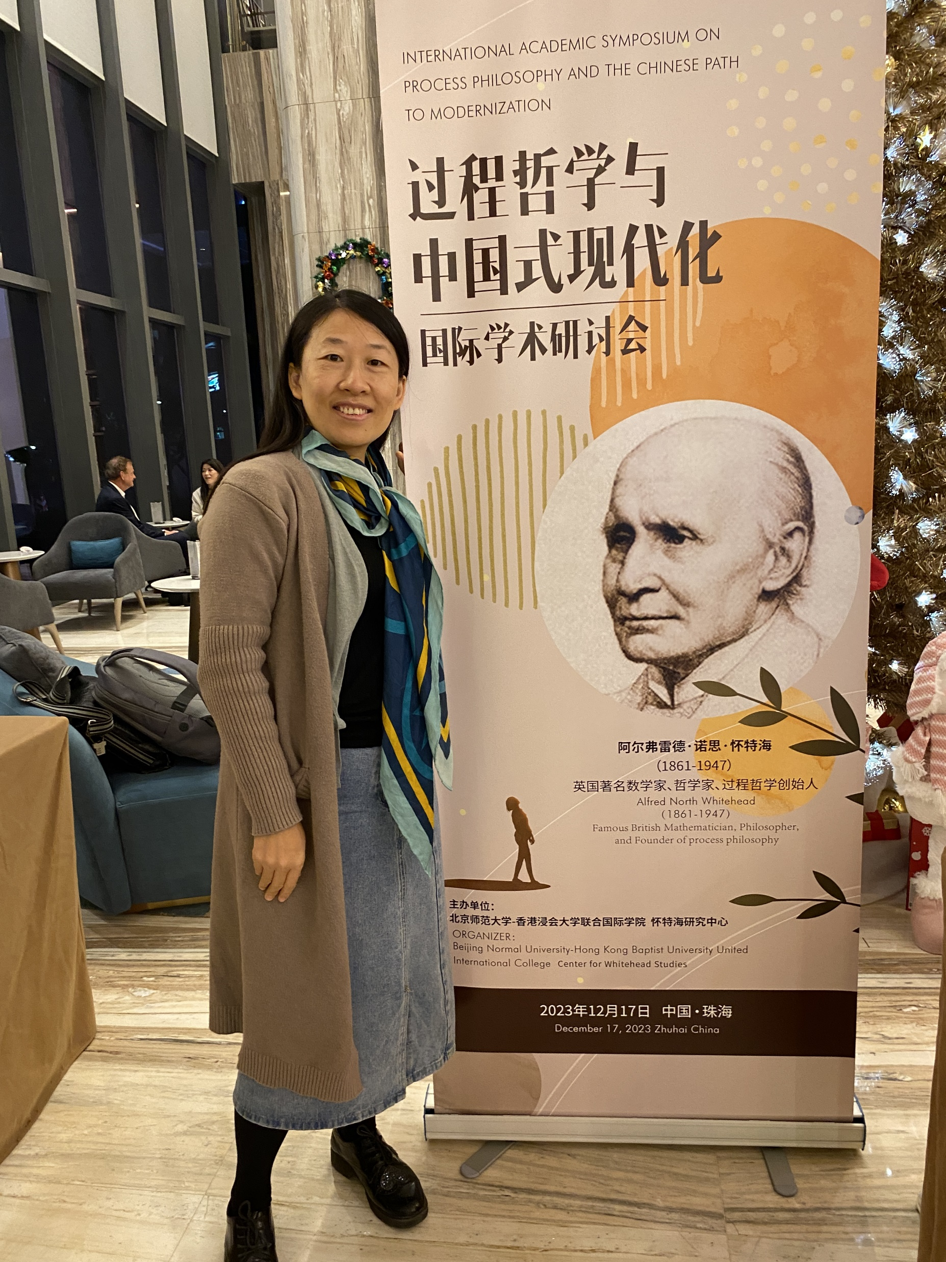
Notes:
Qionghui He, Bahá’í, PhD candidate integrating Anisa, process philosophy, and Bahá’í teachings under the theme of Ecological Civilization.

Slide 74
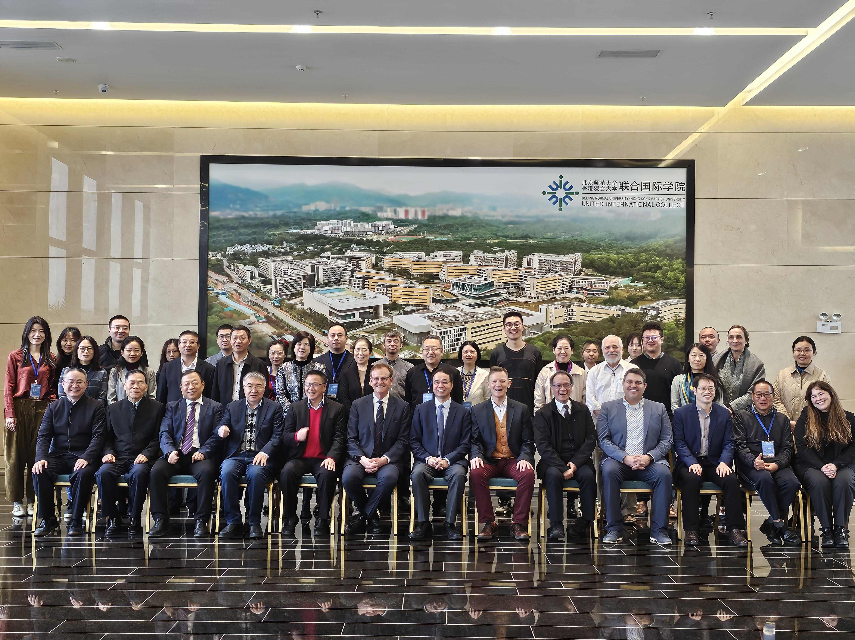
Notes:
“International Academic Symposium on Process Philosophy and the Chinese Path to Modernization,” December 17, 2023, Zhuhai, China. Organizers: Beijing Normal University; Hong Kong Baptist University; United International College, Center for Whitehead Studies. “Alfred North Whitehead (1861-1947), famous British mathemetician, philosopher, and founder of process philosophy.”
Centenary Symposium for date of publication of each of Whitehead’s books, e.g. 2029: Process and Reality.

Slide 75

Next: A Toolbox of Whiteheadian Concepts
Notes:
In this photo, the toolbox and the tools are old and well used, but very effective for creating new furniture, new cabinets, new sculptures, etc. In like manner, even though process philosophy has existed for over a century and WES for sixty-five years, their concepts can be used to create new models of education, new curricula, new teaching methods, new learning experiences, and so on.

Slide 76
Key Concepts of Process Philosophy
scheme of thought:
  coherence
  logical consistency
  applicability
  adequacy
paradigm shift
reality
actual reality
non-actual reality
process
potentiality
actualization
creativity
time inheres in process
interaction
environment
hierarchical ordering
positive prehension
negative prehension
knowing & loving
value
meaning
faith
immanence
transcendence
consciousness
order & novelty
subjective aim & final cause
concrescence
causality:
  material
  efficient
  reciprocal
  formal
  final
  primal
  spiritual
  self
Notes:
Each term has a systemic definition. They are of three types: 1) those that can be understood via dictionary definitions; 2) those that are in common use but are given new meanings; and 3) those that are new words or terms that are used to symbolize new ideas and concepts.
As a school principal, whenever I started at a new school, I asked the teachers, without them being allowed to speak to each other or to carry out an Internet search, to write down (on paper) their definitions of education, teaching, and learning. The wide variety of responses was always fascinating. I would then have these typed up and distributed as an introduction to WESian definitions so that the faculty would at least become aware of their lack of agreement and their principal’s point of view (and expectations). For a faculty to be effective, having an agreed upon understanding of and common definitions of, at least, these three terms is highly beneficial. (Imagine the power of a faculty that shares a common understanding of reality, its purposes, and how human potentiality can be identified, cultivated, and placed at the service of the world!)
Some of these terms will be discussed in the following slides.

Slide 77
EIGHT PRINCIPLES OF PROCESS PHILOSOPHY
Reality is composed of two types of entities—actual entities and non-actual entities.
Actual entities include minerals, human-made constructions, botanical organisms, animals, and human bodies. They are more visible in nature and more directly measurable.
Non-actual entities are more invisible in nature and include such entities as relationships, feelings, thoughts, intentions, souls, the Prophets (after death), the Creator and eternal objects such as ideals, potentialities, and subjective aims that are “breathed into” actual entities by the Creator (the “sum of all potentialities”) via His Manifestations.
Notes:
By having a better understanding of reality, a teacher’s practice is more effective. See the handout titled: “The Wholistic Educational System: First Principles and Corollary Principles.”
It was Alfred North Whitehead who coined the term “creativity” in his book Religion in the Making (1926, p111). Due to the centrality of creativity in his philosophy of organism (and in education), I find this fascinating. Before this, only forms of the verb “to create” were used.

Slide 78
PRINCIPLES OF PROCESS PHILOSOPHY (Cont’d)
Reality is always undergoing a process of change.
There are two forms of change – disintegration and integration.
Creativity (integrative change) is the actualization of potentiality.
Creativity is the universal of universals.
In order for potentiality to be translated into actuality two preliminary processes are necessary:
a. purpose-guided interaction with the environment and
b. prehension of the environment:
1) the inclusion of beneficial entities (positive prehension)
2) the exclusion of deleterious entities (negative prehension).
Notes:
This last Whiteheadian concept (8.a.) was selected as the first principle of the Anisa Model. Together 8.a. & 8.b. form the organizing principle of WES.

Slide 79


A PARADIGM SHIFT FROM
MECHANISM TO ORGANSIM
Notes:
Process philosophy holds that reality is not composed of entities that are physical, billiard-ball-like substances that collide with one another due to external, billiard-stick-type forces (i.e., material and efficient causes), but endless processes, events, or occasions like a dance that exists as an invisible potentiality (subjective aim), then comes into visible existence (actuality) as the dancers come together (interact with one another) drawn by the common goal (final cause) of performing a particular circle dance (integration or anti-entropy), move in rhythmic steps that repeat themselves until the dance ends and the dancers go off on their own (disintegration or entropy). The dance then returns to the realm of potentiality, perhaps to be performed again soon, later, or never again.

Slide 80
Process philosophy holds that reality is not composed of entities that are physical, billiard-ball-like substances that collide with one another due to external, billiard-stick-type forces (i.e., material and efficient causes), but endless processes, events, or occasions like a dance that exists as an invisible potentiality (subjective aim), then comes into visible existence (actuality) as the dancers come together (interact with one another) drawn by the common goal (final cause) of performing a particular circle dance (integration or anti-entropy), move in rhythmic steps that repeat themselves until the dance ends and the dancers go off on their own (disintegration or entropy). The dance then returns to the realm of potentiality, perhaps to be performed again soon, later, or never again.

Slide 81
Part 3:
WES: Its First Principle,
Its Philosophy of Education &
Its Theories
(55 slides)

Slide 82
The organizing principle of WES
The potentiality of an entity is translated into actuality via purpose-guided interaction with and positive and/or negative prehension of its environment.
Po→A←+p Pu/I -p→E
Notes:
Po = Potentiality
→ = Translated into
A = Actuality
PuI = Purpose-guided Interaction
←+p = positive prehension
-p→ = negative prehension
E = Environment
In the bottom formulaic expression, the arrow flowing to A symbolizes the positive prehension, inclusion, or absorption of environmental entities. The arrow flowing to E symbolizes the negative prehension, exclusion, or rejection of environmental entities, whether they be physical, social, psychological, or spiritual in nature. Again, the two-way arrow between the actual entity (A) and the environment (E) signifies that both the entity and the environment are influenced, impacted, or changed in some way via purpose-guided (Pu) interaction (I), that is, the causality is reciprocal.
Refer to the handout titled “An Explanation of the Key, First Principle or Organizing Principal of The Wholistic Educational System” which explains these concepts:
First principle
Potentiality
Actuality
Creativity
Purpose-guided Interaction
Environment
Prehension: negative and positive

Slide 83

Notes:
This microscopic photo* of an embrionic stem cell illustrates a way of understanding the philosophy of organism as being celular in nature. Like cells, entities—physical, e.g. animals; social, e.g., families; psychological, e.g., concepts (which can also evolve over time); or spiritual, e.g., souls—have an “inside,” an “outside,” a “boundary,” such as a cell wall, separating them, and “channels” across the boundary that connect the interior with the exterior of the entity and which can be opened or closed.
* https://depositphotos.com/photos/cells.html?qview=647917918

Slide 84
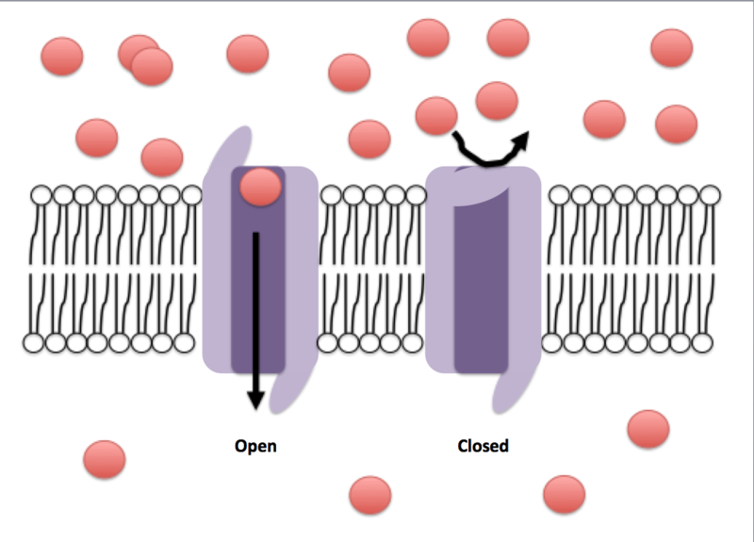
Notes:
This illustration* shows the movement of ions (red circles) across a cell membrane through an open, ion channel and their not being allowed to flow when an ion channel is closed.
The drawing symbolizes the concept of prehension. The cell wall “feels” (prehends) both what it wants to absorb and what it wants to reject. Positive prehension is symbolized by the open ion channel that allows for the flow of external ions into the interior of the cell through the cell wall. Another example of positive prehension would be the eating and metabolization of food.
Negative prehension is the decision to exclude an external entity. For example, if a food is first smelled (felt), or even ingested, and found to be spoiled, it is not eaten or digested, that is, it is negatively prehended, rejected, or ejected! Entities with healthy “cell walls” allow passage to only those entities that are "in tune" with their nature or purposes. They do not allow the passage of entities that are harmful to these purposes. Therefore, weak "cell walls," barriers, shields, or boundaries jeopardize the true nature, purposes, and lives of entities at all ontological levels whether individual or collective.
*https://en.m.wikipedia.org/wiki/File:Open_and_closed_conformations_of_ion_channels.png

Slide 85
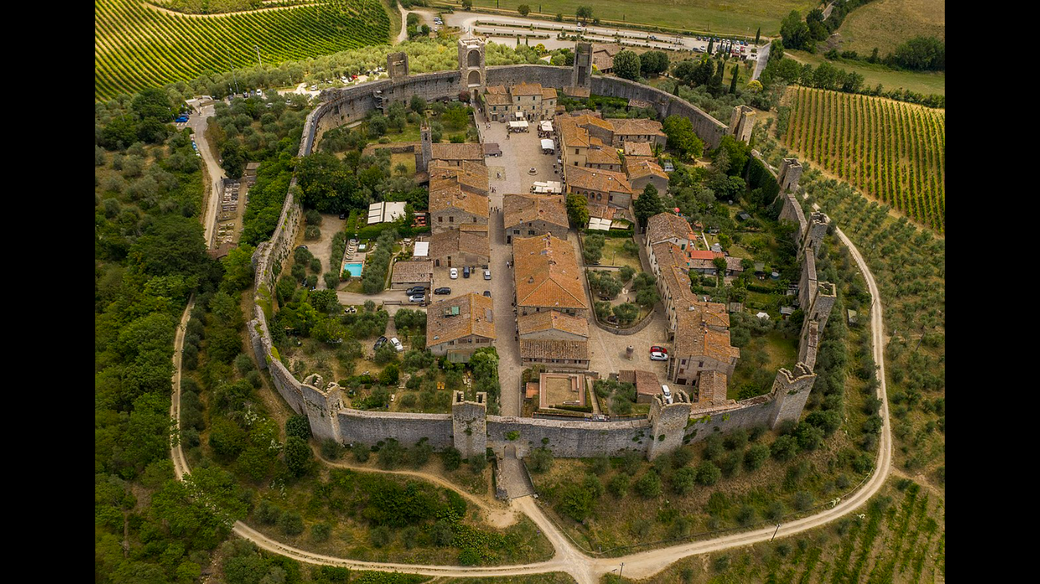
Notes:
This photo illustrates the cellular nature of organisms at a higher ontological level, that of a human community.
Monteriggioni is a medieval walled town in Tuscany, Italy, situated on a natural hill, built by the Sienese between 1214 and 1219 as a front line in their wars against Florence. The castle walls, with their watchtowers, offer views of the surrounding Chianti region. The old town is accessed through the Porta Franca gate.
Like other organisms, Monteriggioni contains potentials to be actualized, e.g., its ability to defend the capital of the kingdom from its strategic location and the talents of its citizens, interacts with its environment in order to attain these ends, positively prehends what its needs, and negatively prehends unwanted entities.

Slide 86

Notes:
On another scale, great walls act as cell walls for prehension: The Great Wall of China, Hadrian’s Wall dividing Romanan Britain from what is today Scotland, The Berlin Wall, the wall dividing Israel from Palestinian Authority, and the wall dividing Mexico and the U.S.

Slide 87
How is the actualization of learners’ potentialities often blocked?
What happens if the actualization of their potentiality is blocked?
Po A
ACTUALIZATION
Notes:
As an overly broad generalization, one can see in society that frustrated extroverts act out and use violence to achieve their ends and end up in prison. Frustrated introverts withdraw, become depressed, use drugs to deal with problems, and/or become mentally ill. They can end up in mental institutions, become homeless, or, even worse, commit suicide.
The amount of money spent by society on prisons and mental health is extreme. This approach to human development, without eliminating any necessary judicial punishments for breaking laws, would indicate that funds would be better spent in enabling these people to actualize their potential so that they can contribute to their own prosperity and that of society. Even persons condemned to life imprisonment without parole due to their crimes, can be educated to perform from inside the prison some service for others as a means of developing their soul and preparing it for life after death in the next world.
Fear-related feelings caused by stress and trauma block the actualization of potential. (Neurological research has now found how this happens in the brain.) Typical responses include: fight, flight, or freeze. Examples in schools include feeling unsafe, fearing being bullied, having severe test anxiety, and fearing public humiliation by the teacher or by failing to meet a wide variety of expectations.
Mel Levine, the author of The Myth of Laziness found that in schools, what is seen as “laziness” is actually the result of “output failure,” that is, the lack of productivity, especially in the area of written language. (Students would rather be labeled “lazy” than “dumb.”) In these cases, by focusing on helping students to actualize their writing potential, this frustration was eliminated along with the “lazy student” label.
A constant question then for a teacher and a school is: “Is what I am saying or doing (or we are doing) facilitating the release of the learners’ potentiality, that is, their talents or abilities, or, is what I am saying or doing blocking the actualization of potential?

Slide 88
Po→A←+p Pu/I-p→E
Although environmental entities and the human potentialities that enable us to be effective with them are innumerable and are seamlessly connected with one another, they are ordered hierarchically. Hence, for managerial and practical purposes, in WES, they have been classified into five domains of the environment and five types of potentiality:
- physical environment physical potentialities
- social environment social potentialities
- psychological environment psychological potentialities
- spiritual environment spiritual potentialities
Notes:
It is also posible to generate:
four modes of interactions—physical modes such as touch, social modes such as conversation, psychological modes such the contemplation of feelings and ideas, and spiritual modes such as prayer;
four types of positive prehension—physical, e.g., metabolism of nutrients; social, e.g., making new friends; psychological, e.g., allowing love to flow into one’s life; and spiritual, e.g., studying sacred scripture.
four types of negative prehension—physical, e.g., living in a gated community; social, e.g., on Facebook, “unfriend” a person who is a bad influence; psychological, e.g., changing an agressive thought into one of patience; and spiritual, e.g., avoiding people that are materialistic and ungodly; and
four categories of actuality—physical competence, social competence, psychological competence, and spiritual competence; competence being defined as the ability to achieve a high degree of correspondence between intended outcomes and actual outcomes in relation to the entities in each environment.

Slide 89
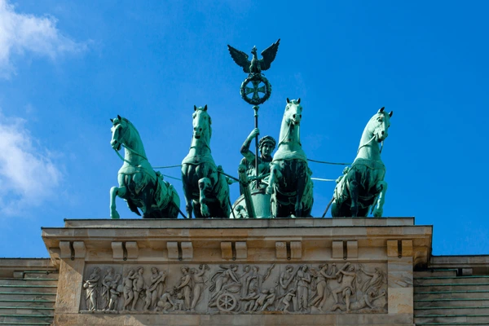
Notes:
The Quadriga was placed on top of the Brandenburg Gate by Johann Gottfried Schadow in 1793. The sculpture, depicting a two-wheeled chariot pulled by four horses running side by side, was meant to symbolize peace entering the city. The horses' reins are held by Victoria, the goddess of victory. https://www.berlin.de/en/attractions-and-sights/3560266-3104052-brandenburg-gate.en.html#:~:text=The%20Quadriga%20was%20placed%20on,Victoria%2C%20the%20goddess%20of%20victory
In WES the four stallions empowering the system as subjective aims luring learners forward are: physical competence, social competence, psychological competence, and and spiritual competence. These, in time, will, as heralded by The Quadriga, will inaugurate an age of physical peace, social peace, psychological peace, and spiritual peace.

Slide 90
PHYSICAL ENVIRONMENT
SOCIAL ENVIRONMENT
PSYCHOLOGICAL
ENVIRONMENT
SPIRITUAL ENVIRONMENT
ENVIRONMENT OF THE SELF
HIERARCHICAL ORDERING OF THE ENVIRONMENTS
Notes:
This Whiteheadian concept – that reality is organized hierarchically -- requires even a quark (placed in the inner circle) to “belong” to its own ontological level and to the higher-order environments by having a “life” that is not only physical but also social, psychological, and spiritual in nature.
A quark behaves as a material entity but it cannot exist in isolation from its “social” environment of other material entities.
Physicists have attributed even to a quark a tiny amount of self-determination and choice rendering its behavior “not always predictable” and thereby recognizing the “mental” or “psychological” aspect of its nature.
In my opinion, anything created by the Creator has, at least, a “spark” of the Creator; a spiritual aspect of its nature. Just as a drop of water proceeding from the ocean contains attributes of the ocean, so does even a quark manifest one or more attributes of its Creator. One divine attribute of quarks is “service to others,” because without them, the higher levels of the contingent domains could not even exist.
The Creator also has all of these aspects of reality. A Creator without a material creation is unimaginable, just as a king without a kingdom makes no sense. The Creator is also “social” in relation to His creatures – caring for them, answering their prayers, verbalized or not, etc. And He certainly has a “psychological” nature full of feelings, thoughts, purposes, and plans as revealed via His/Her Prophets. His distinctive, spiritual nature is, for human beings, including the Prophets, ultimately unknowable, unfathomable, invisible, and transcendent.
For lack of a better way to diagram the environment of “the self” of the learner, and with no intention of showing disrespect to the All-Comprehensive Creator, I placed the Environment of the Self in the outer sphere. Human beings are at the peak of the pyramid of creation (with the exception of the Manifestations of God and ‘Abdu’l-Bahá during the time that They walked the earth). We are “contained” in the universe and we also “contain” the universe. Our body is composed of minerals. For digestion, we depend on the millions of bacteria from the plant kingdom. We also manifest the vegetable powers of growth and reproduction. We have an animal aspect of our nature expressed through the senses, ingestion of food, and the sex impulse. At our distinctively human, ontological level, we have a rich mental and spiritual life with powers that distinguish us from the animal kingdom such as complex language, writing, complex thought, collective memory, the ability to become a self-chosen type of craftsperson or professional, and the capacity to be the “image of God” by manifesting all of Her/His names and attributes in our lives.

Slide 91
The Philosophy of Education of the Wholistic Educational System
The aim of education is to enable the learner to become a life-long learner and teacher of her/his self and others; a learner who is able to consciously and continually:
Notes:
1. WES is based on a “talents” approach to education rather than a “deficiency” approach. Its primary focus, for example, via diagnoses, is to find the interests, passions, strengths, and talents of a learner. Identifying needs, weaknesses, and gaps is secondary. The former are continually developed and used as a foundation for addressing, strengthening, or “filling in” the latter.

Slide 92
  (1) discover, actualize, develop, expand, and refine, at an optimum rate, her/his potentialities, that is, her/his latent, special, God-given talents and other capacities which are physical, social, psychological, and/or spiritual in nature;

Slide 93
(2) acquire beneficial knowledge, symbol systems, skills, habits, values, virtues, higher-order competencies, and ideals while rejecting all that is detrimental to her/his well-being;
Notes:
2. “Knowledge in this statement includes both process knowledge (e.g., how to think or know) and content knowledge (e.g., what to think or know). Determining what universal, national, and local knowledge and skills are beneficial and useful at the present moment in the life of the learner and for decades into the future is a highly important curricular decision. The value of local knowledge and learning to love the place in which they live, offers students many concrete experiences which are richer and, therefore, more memorable than “textbook” experiences. Also, so often, from the local phenomena and history, universal lessons can be induced and transferred to the understanding of other local, regional, national and international phenomena and history.
Note: I was delighted to be able to contribute to the founding of the International Association for the Advancement of Curriculum Studies at Louisiana State University in the year 2000. (The first such organization at the international level in the world.) To be able to interact with curriculum experts from all continents of the world deepened my understanding of the great diversity and commonality of the issues facing curriculum developers in particular and all educators in general.

Slide 94
(3) place all of the above at the service of the world;
Notes:
3. Becoming only knowledgeable and skillful to earn an income represents an incomplete education. Applying knowledge and skills to improve the world is also necessary and is an aim that gives meaning to work. Hence, service education is an essential component of WES. By “world” is meant “all things everywhere.” Therefore, students might not only focus on improving the life of humans but also the life of rivers, oceans, forests, deserts, animals, nature preserves, eco-systems, etc. – both locally and in other parts of the world.

Slide 95
(4) know, love, and worship the Creator through knowing and loving His/Her Manifestations, their Revelations, and His/Her creation (which includes one’s self);
Notes:
4. We learn to know the Creator through two “books”: the revealed Holy Books of the great world religions and the “book of creation” or nature, including humans.
The Sacred Texts come to us from the Creator about every thousand years.
We learn to love the Creator through, for example, prayers of praise or worship and by showing love to all His/Her creatures.
Everything in nature manifests one or more attributes or names of the Creator and can be used as a metaphor to understand the invisible, spiritual aspects of reality. For example, a fruit tree can be used as an example to understand the Creator’s generosity – continually giving without expecting anything in return. The sun, the source of physical life, can serve as a metaphor for God as the Source of the spiritual energy that keeps us motivated and growing closer to Him.
Hence, every natural science lesson can also become a spiritual lesson. This could be considered as one of the ways that educators can “cast the sleeve of holiness” over all things:
A race of men … incomparable in character, shall be raised up which, with the feet of detachment … and will cast the sleeve of holiness over all that hath been created from water and clay. –Bahá’u’lláh (quoted by Shoghi Effendi in The Promised Day Is Come)

Slide 96
(5) actualize the potentialities of other people, social entities, and other aspects of the world; that is, to strive to bring about the highest good for all people and all other things everywhere;
Notes:
5. The learner learns to actualize not only her or his own potentialities but also those of other individuals and collective entities – siblings, family, friends, neighborhood, school, community and so on in ever greater spheres of endeavor.

Slide 97
(6) carry forward an ever-advancing, sustainable civilization characterized by the recognition of the inter-relatedness of all things, the oneness of God, the oneness of religion, and the oneness of humanity; the appreciation of human diversity; the establishment of a divinely-inspired global order; the implementation of social justice; and the enjoyment of international harmony and world peace; and
Notes:
6. Social life has evolved from the family, to the clan, tribe, city-state, and nation. Now is the time to take the next step in social evolution – planetary unity. The world civilization to be developed must be based on the concept of the organic oneness of humanity and balanced in its physical, social, psychological, and spiritual dimensions.

Slide 98
(7) prepare her/his soul for the afterlife.
Notes:
7. An example of spiritual science, is the formal research taking place at universities that collect and analyze what are termed Near Death Experiences. The evidence for the existence of an afterlife can probably never be conclusively proven but the body of research confirming the probability of its existence is substantial and growing.
The preparation of the soul for the afterlife does not begin at the age of retirement. Rather, because this “womb-world” is a preparatory phase for the soul’s journey to the next spiritual world, preparation needs to begin at the time of conception through the prayers of the mother and others and then continues throughout the entire lifespan. I tell my students that my job as a teacher is to prepare them for success with many upcoming tasks and phases of life:
Their classwork and homework assignments
Weekly tests
The unit, quarter, semester, final, and achievement exams
The next grade level
The next level of schooling: elementary school, middle school, high school, or college
For daily life, married and family life, and their work life
For life during retirement
And for life beyond this life
After I put these on a horizontal timeline on the white board with vertical lines marking 20, 40, and 20-year segments of life followed by a longer extension of the timeline with an arrowhead representing eternity, i.e.:
a segment representing 20 years of learning,
a segment twice as long representing 40 years of vocational or professional achievement and perhaps, family life, and, if they are fortunate:
a segment representing 20 years of enjoyment of retirement, followed by:
a long segment ending with an arrowhead symbolizing eternity.
____20____l________40___ ___l___20____l_____________________________________________________>
After comparing the length of the line segments, I ask them which is the most important in terms of length of time. Seeing life on earth as a brief, 80-times-around-the-sun, marry-go-round “whirl” and as only a preparatory phase for eternity, just as the womb-life of the infant is a preparation for life beyond womb of the mother, helps students to understand the greater importance of what we can take with us – our virtues , character, and relationships* – as compared to the less importance things that we have to leave behind, e.g., money, possessions, property, titles, material-life skills, etc.
*The inclusion of these themes in the curriculum, via this exercise, is thus clearer and more justified in the minds of the students.

Slide 99
THEORIES OF HUMAN DEVELOPMENT
INCLUDED IN WES’s RESEARCH REVIEW
Preformationism
The Environmentalism of John Locke
The Romantic Naturalism of Jean Jacques Rousseau
The Maturational Theory of Arnold Gesell
The Theory of Evolution of Charles Darwin
The Ethological View of Child Development of John Bowlby
The Educational Philosophy of Maria Montessori
The Organismic and Comparative Theory of Heinz Werner
The Cognitive-Developmental Theory of Jean Piaget
The Stages of Moral Development of Lawrence Kohlberg
The Psychoanalytic Theory of Sigmund Freud
The Eight Stages of Life of Erik H. Erikson
The Theory of Adulthood of Carl G. Jung
The Theory of Motivation of Abraham Maslow
The ANISA Theory of Development of Daniel C. Jordan
The Developmental "Imitative" Social-Self Theory of James Mark Baldwin
The Theory of Language Development of Noam Chomsky
The Stages of Intellectual Development of Lev Vygotsky
The Theory of Structural Cognitive Modifiability of Reuven Feuerstein
The Theory of Multiple Intelligences of Howard Gardner
Notes:
According to Dr. Jordan in his lecture at Maharishi International University, forty-some theories of learning were reviewed and synthesized into a general theory of learning. These can be found in the bibliography of Magdeline Carney’s dissertation.
Additional sources of the Anisa Model that were not included in my own review of the literature were: Harris, Buhler, Bonner, Epstein, Scott, Mussen & Langer, Havinghurst, Hunt, and Werner.
This long list of foundational sources allows us to appreciate the comprehensiveness of the review and the theories that contributed to the WESian theory of development. It also shows why it can be referred to as a “human development-based system.”
This review was a component of my doctoral program and was supervised by Dr. George Bondra, a member of my doctoral committee, a practicing psychologist, and, according to Dr. Jordan, one of the principal contributors to the development of the Anisa Model at the University of Massachusetts, Amherst.

Slide 100
LEARNING THEORIES REVIEWED IN THE ANISA MODEL
Gagne’s Eight Types of Learning
Walter’s brain wave theory
Tolman’s sign learning
Lewin’s field theory
Snygg and Combs’ perception theory
Bandura’s social modeling theory
Mowrer’s two-factor learning theory
Newell and Simons’ information processing theory
Piaget’s theory
Miller, Pribram and Galantar’s TOTE theory
Pavlov’s, Watson’s, and Skinner’s conditioning theory
Harlow’s learning sets theory
various mediation theories and others
Notes:
From article “The Anisa Model of Education: A New Basis for Educational Planning,” in Young Children XXVIII(5), 296-297 by Daniel C. Jordan and Donald T. Streets.

Slide 101
Key Concepts of the Theories of Development and Learning
Development
  Individual
  Social
Learning Paradigm
  Romance
  Precision
    Differentiation
    Integration
  Generalization
The 5 Hierarchically Ordered Environments
  Physical
  Social
  Psychological
  Spiritual
  The Self
The Cross-Domain, Manifold Environment:
  The Known
  The Unknown but Knowable
  The Ultimately Unknowable
Notes:
The definition of development and the terms used in the learning paradigm will be explained later in this presentation. Regarding “The Five Environments,” as has been mentioned before, although the environment is whole and seamless and existing entities can be classified in different ways, for practical, organizational, and educational purposes, in WES, entities in the environment have been categorized as being (1) physical (or material), (2) social, (3) psychological, or (4) spiritual in nature. A fifth category is all of these applied to the “self.” Each of these environments has three aspects: “the known,” “the unknown but knowable,” and “the ultimately unknowable.” These can be considered cross-domain environments. Hence, WES also refers to these domains or dimensions as (1) the physical environment, (2) the social environment, (3) the psychological environment, (4) the spiritual environment, (5) the environment of the self, (6) the environment of the known, (7) the environment of the unknown but knowable, (8) and the environment of the ultimately unknowable.
The definition of development and the terms used in the learning paradigm will be explained later in this presentation.

Slide 102
Development is the process of
translating potentiality of an entity into actuality via purpose-guided interaction with and positive and/or negative prehension of the environment.
Notes:
This definition of development is based on Whitehead’s “universal of universals” – creativity: the actualization of potential, thereby rendering the theory of development coherent with both the process philosophy that undergirds WES and the educational philosophy of WES.

Slide 103
Intelligence(s) =
Heredity (Genetic Endowment) x Interaction x Environment
The degree of intelligence is determined by: the quality of the genetic endowment (heredity), the quality of the environments (epigenetics)
– physical, social, psychological, and spiritual -- and the quality or richness of the interaction between the two.
IQ(s) = H x I x E
Notes:
The “(s)” after “intelligence” is important. There is now ample evidence supporting the theory that, instead of there being a single “general intelligence,” there are multiple intelligences: linguistic, musical, logical-mathematical, spatial, bodily-kinesthetic, interpersonal, intrapersonal, naturalistic, and, pending more research, possibly existential. (See the work of Howard Gardner on multiple intelligences, especially his book Frames of Mind.)
The vertical, double arrows symbolize the quality of each variable being high or low, increasing or decreasing.
The traditional debate in the field of human development has been “nature vs. Núrture.” According to the research base of this theory, there is no more debate. The answer is “both,” i.e., nature and Núrture are factors in development and the degree of intelligence. And the discussion has now become more complicated by the introduction of a third variable, the quality of the interaction between genetic endowments (potentialities) and the environment(s). The quality of interaction can be increasing by having a well-educated parents, especially the mother, teachers, and, according to more recent search, turning certain genes “on” or “off” via epigenetics, especially through diet, resulting in outcomes that can be healthy or unhealthy.
Regarding these three variables, historically, it has been possible to manipulate the quality of the environment and the quality of the interactions. The only legitimate means for improving the genetic endowment of offspring was via the intentional selection by a parent of an intelligent spouse. However, current research in the field of gene therapy is opening up possibilities for manipulating the genetic endowment, hopefully for the betterment of the human race, for example, to cure genetic disorders. (See, for example, “Genetics” at MedlinePlus: https://ghr.nlm.nih.gov/primer/consult/treatment.)
Research in the field of epigenetics is also demonstrating how lifestyle factors such as nutrition, exercise, stress control, sleep, social relations, and challenging learning can positively influence “gene expression” which, in turn, helps to prevent autoimmune diseases such as Type 2 diabetes. See, for instance, “Epigenetics Expert Dr. Jay Goodbinder On How Your Lifestyle Affects Gene Expression” at: https://www.youtube.com/watch?v=z2oHqCiLydI. Note: On December 8, 2023 the U.S.’s Food and Drug Administration “approved the world’s first medicine based on CRISPR gene-editing technology, a groundbreaking treatment for sickle cell disease that delivers a potential cure for people born with the chronic and life-shortening blood disorder.” (“In historic decision, FDA approves a CRISPR-based medicine for treatment of sickle cell disease” by Adam Feuerstein. https://www.statnews.com/2023/12/08/fda-approves-casgevy-crispr-based-medicine-for-treatment-of-sickle-cell-disease/.)
Note: Heredity, in relation to the learner’s immanence, in addition to the genetic endowment, could also include aspects of the learner’s physical (e.g. inheritance), social, psychological, and spiritual heritage, all of which can impact measurable intelligence.

Slide 104
Human Creativity as a Spectrum
Human creativity or actualization of potentiality ranges from the simple to the complex, from “common” accomplishments to “game-changing” individual or group creations or inventions; for example, from learning to walk and talk; to the use of wheel-based transportation; to the invention of smart phones.
C → C → C → C → C → C → C → C → C → C → C →
Hence, the first steps of a child, a novel accomplishment for her or him, needs to be celebrated as much as humankind’s creation of the Smart Phone.
Notes:
One of my special education teachers thanked me for this concept because the accomplishments of her students were often small “c’s” compared to the large, capital “C’s” of grade-level expectations and this idea helped her to legitimately honor and celebrate their achievements and to increase their happiness and their joy of learning.

Slide 105
THEORY OF LEARNING: SYSTEMIC DEFINITIONS
Experience: interaction of an entity with its environment(s) which is usually guided by purpose.
Interaction: an exchange of "energy" (physical, social, psychological, or spiritual) between two or more entities.
Environment: all entities in the universe with which humans interact either individually or in various combinations. The entities have been categorized as being physical, social, psychological, or spiritual in nature including the “known,” “unknown but knowable,” and “ultimately unknowable” aspects of these four and the human “self” which is a composite of all of these entities.
Objects of knowledge: any aspect of the environment(s) which has been selected for learning.
Notes:
Just as multiple intelligences theory breaks down the concept of IQ into 8 or 9 brain-based categories, so does WES break down the concepts of environment, energy, and objects of knowledge into four categories: physical (or material), social, psychological, and spiritual.

Slide 106
The Rhythm of Learning
Learning: the hope-or-fear-based differentiation, integration and generalization of experience.
- Learning is part of human nature; e.g., aural & oral language learning are innate potentialities.
- When teachers arrange experiences to allow learning to take on its natural rhythm, it is characterized by three phases:
“romance,” “precision,” and “generalization.”
-They describe a natural pattern of learning that takes place during an individual lesson or curricular unit, or across several years of a learner’s life.
Notes:
The concept of “Rhythm of Learning” is from Alfred North Whitehead. It offers a simple yet profound scheme which can integrate a large body of learning theory and research and a practical means for teachers to diagnose the learning status of students and prescribe learning experiences for them.
The inclusion of the term “hope-or-fear-based,” acknowledges the importance of the affective state of the student and her/his “readiness to learn.” WES holds that there are two basic emotions – fear and hope. There is beneficial, fear-oriented learning that can keep us away from learning or prehending unwholesome substances and objects of learning such harmful games.
What we want students to learn, e.g., the reading component of the curriculum, needs to be hope-related. Fear, for example, of reading, can block learning this object of learning which should not be feared because it supports further actualization of potential in other areas of the curriculum. Hence, one of the responsibilities of the teacher is to do her or his best to foment hope-related feelings towards the upcoming learning experience. This is referred to as the “romance” phase of learning (and is often skipped in traditional, fill-the-empty-vessel-type education.)
The concept of learning as the differentiation, integration, and generalization of experience is based on the research and thinking of Daniel C. Jordan and the dissertation of Magdalene Carney titled The Learning Competence Paradigm of the Anisa Model and the Preparation of Teachers.

Slide 107
Romance
Romance is a motivational stage during which hope-related emotions are associated with the object of learning. “Glimpses” of what is going to be learned generate curiosity, interest, and a desire for mastery.
Notes:
Research confirms that during a learning experience, the data coming in through the senses is first processed in the emotional areas of the brain. That is, the first reaction to input from the environment is for the brain to perceive it as fear-related or hope-related. If the learner is already in a state of anxiety, nervousness, or fear or the learning experience produces these feelings, learning the object of knowledge will be partially or completely blocked and the learner’s reaction will be one of fight (e.g., misbehavior), flight (e.g., literally escaping from the learning environment [or dropping out of school]), or freeze (e.g., retreating into an interior world via daydreaming and other such means). If the learner arrives with feelings of hope, safety, positive expectation, and interest and the learning experience evokes these same feelings, then the brain will be more open to learning the selected object of knowledge. The task of the educator then is to do her or his best to lower fear-related feelings of insecurity and anxiety and to increase hope-related feelings of excitement and fervor about learning something novel and interesting.

Slide 108


Slide 109
Precision
Precision emphasizes the acquisition of curricular objectives (while maintaining the interest generated during the phase of Romance) via two sub-processes -- differentiation and integration.
Notes:
In WES, the Whiteheadian phase of precision subsumes the two, learning abilities--differentiation and integration—as set forth in the Anisa Model of Education.
This is the phase of hard work, practice, making mistakes, trying again and again, until a degree of mastery is achieved. With a clear vision of the goal maintained, sacrifices of time and energy are made willingly.

Slide 110
Precision: Differentiation
Differentiation is the ability to break down experience, whether internal or external, into separate, contrastable elements.
Notes:
Once a teacher understands the differentiation involved within a learning activity, a deeper level needs to be grasped in which the learner is also differentiating and integrating the present experience (via comparison and contrast) in relation to past experiences (activating background knowledge with our without the help of a teacher). I refer to this as the “journey within the learning activity” and the “journey without the learning activity” to former experiences. For example: Driving through the country a child sees cows and calls them horses. S/he has differentiated and integrated some attributes from past learning experiences: relations of size, color, four-leggedness, head, tail, etc., but still needs to further differentiate and integrate distinguishing features such as horns, milk bag, udders, proportion of body and legs, etc. This whole process gradually corrects and refines the learner’s former concepts or “maps” of reality.
One author criticized this paradigm because it places the parts (differentiation) before the whole (integration). Such is not the case in practice. In this statement, even though the word “differentiation” precedes the word “experience,” the learning activity begins with a “whole” experience, i.e., a purpose-guided interaction with an “arranged environment” which could be a letter of the alphabet composed of different types of lines, a box of blocks of various colors and/or forms, a field trip, or a dream. The next step is to differentiate or break down that “whole” experience into contrastable elements.

Slide 111
Precision: Integration
Integration is the ability to combine those elements in the same way or in a new way thereby providing new perceptions, new movements, new relationships, new feelings, new thoughts, new information and/ or new skills, etc., which may or may not become expressed immediately in some form of overt behavior.
Notes:
On one level of integration, the “parts” need to be integrated into a new “whole” and, on another level, the new “whole” needs to be differentiated from and integrated with other “wholes” outside the learning experience. Again, this is done by comparison and contrast with previous experience (background knowledge) either by the learner alone or as facilitated by a teacher.
For example, putting the notes of a traditional song together might be "new" to students who could learn this song by listening to it without having to demonstrate their new learning by singing or playing it. (Hence, the weakness of considering expressed behavior as an essential component of learning. [A critique of behaviorism and behavioral goals.]) The students could also, with the same musical notes of the traditional song, compose an original songs. This would also be something "new" to them.

Slide 112
Generalization
Generalization is the ability to utilize the recombination of integrated elements in other situations. It is the stage of mastery during which the learner feels the satisfaction of being able to apply newly acquired knowledge and skills in new ways thereby returning to a highly motivating phase but one which is now based on a feeling of competence.
Notes:
This is the phase of transfer or application of learning. Some learning theorists say that learning has not truly occurred until generalization takes place. Knowledge known but not applied is referred to by Whitehead as “inert ideas,” one of his major criticisms of traditional education in which knowledge can be expressed or “declared” (often after being memorized) but not used.
In training a child to activity of thought, above all things we must beware of what I will call "inert ideas" -- that is to say, ideas that are merely received into the mind without being utilised, or tested, or thrown into fresh combinations.
--Alfred North Whitehead (Aims of Education, p1)

Slide 113
Learning Competence
Learning competence is the conscious ability to motivate one’s self to differentiate experience by breaking it down into contrastable elements, integrate the elements in novel ways, and generalize the novel integrations to new situations.
Notes:
One way that I have found to increase students’ consciousness of the learning process is to “give” them my own thinking and vocabulary (a form of scaffolding). For example, when introducing to a primary school class a sample puzzle from a new set of puzzles, I verbalize my thinking as follows [comments are in brackets].
This puzzle looks interesting. [This is my motivating romance phase and I am looking at the puzzle as a whole.] I am going to carefully place it on the rug. Now I am going to quietly remove the pieces, mix them up, and place them “face” up. Have I seen a puzzle like this before? [I am activating my background knowledge, comparing this puzzle experience with my previous experiences with puzzles] How can I break the set down into parts, sub-sets, or categories? I think I will separate [differentiate] the edge pieces, the sky pieces, and the flower pieces. How can I begin putting the parts together? I will begin with the edge pieces.
Notice, class, that I am first looking at all of the puzzle pieces. Then I begin noticing the ones that are different in some way and the ones that are alike in someway. For example, the ones that are edge pieces, which I set aside, and the ones that are not edge pieces, which I put together. After I put together the edge pieces, I look at the others to find how they are different and alike, that is, the sky pieces and the flower pieces. After I put together the flower and the sky, I try to see how I can put the sky and the flower together. Gradually, I complete the puzzle. Class, could I use this same thinking to work a new puzzle? What do you think?
Note: I have found it fascinating how (1) some students only “do” a puzzle once, (2) others enjoy doing the same puzzle over and over again getting faster each time, and (3) students get better and faster as they differentiate a new, whole puzzle into its parts, integrate those parts into a whole, and transfer this ability to new puzzles.
As the student’s consciousness or awareness of her/his learning experience increases, s/he becomes more independent from the scaffolding of the teacher. Using the language of the learning theory (exactly or with simpler words depending on the developmental level), students can begin to apply it as a strategy to approach new learning experiences.
A reminder: the term “novel” in the definition of learning competence, is in relation to the learner, e.g., learning a traditional folk dance could be novel for a learner. But the learner’s new integration of dance steps could also be “novel” for the world, i.e., the learner could create a new, unique dance that no one has ever seen before.

Slide 114
The theory of curriculum has drawn on the work of:
- Daniel Jordan & Donald Streets
- John Goodlad
William Doll
Hilda Taba
James B. MacDonald
Jerome Bruner
Beauchamp
Ralph W. Tyler
Elliot
Foshay
Tanner
Notes:
As with the other foundational sources, it is beyond the scope of this presentation to summarize the contributions of each of these theoreticians.
See “New Basis,” p

Slide 115
Key Concepts of the Theory of Curriculum
From the curriculum framework chart:
5 horizontal strands: Ph, So, Ps, Sp, Self
8 vertical strands:
  Process curriculum
  (innate potentialities)
  2. Declarative knowledge (cultural
  content curriculum)
  3. Procedural knowledge (skills)
  4. Symbol systems
  5. Values (⊃ good habits & virtues)
  6. Ideals
  7. Higher-order competencies
  8. Curriculum of the Self
Cross-domain strands:
  Known
  Unknown but knowable
  Ultimately unknowable
Supplementary Curricula for:
  Causality,
  Regulatory Systems,
  Negative Prehension, and
  Role Models
Effectance Motivation
Learning Competence
Fiducial Competence
Self-teaching Competence
Notes:
These concepts are included in the Basic Curriculum Framework Chart and in the Supplementary Curriculum Framework Chart. Each term has a systemic definition which will be included in the glossary of the forthcoming book on WES.

Slide 116
TRADITIONAL VS. WESian EDUCATION
Traditional education emphasized the transmission and acquisition of cultural knowledge through the content curriculum, that is, the “what to know” curriculum using principally symbol systems to express declarative knowledge.
WES balances this with the identification of and actualization of learners´ innate potentialities, talents, and latent abilities through the process curriculum, that is, for example, how to learn, to move, to love others, to think, to manage emotions, and to worship.
When cultural content is combined or fused with processes, procedural knowledge or skills emerge. These, in turn, are placed at the service of society, that is, the service of all things everywhere.
Notes:
With the explosion of content knowledge and its ease of access through the Internet, the process curriculum, often neglected in traditional, assembly-line-type education, takes on great importance.
Nevertheless, having a strong short-term, long-term, and working memory of content knowledge pertinent to a learner’s survival, social life, work, and leisure continues to be highly important. For example, a complex problem that needs to be solved urgently or in an emergency situation (or even an intelligent conversation) does not allow for the time needed to look up the wide array of pertinent information on the Internet, listen to or read it, and comprehend it.

Slide 117
PHYSICAL ENVIRONMENT
SOCIAL ENVIRONMENT
PSYCHOLOGICAL
ENVIRONMENT
SPIRITUAL ENVIRONMENT
ENVIRONMENT OF THE SELF
HIERARCHICAL ORDERING OF THE ENVIRONMENTS
Notes:
This Whiteheadian concept – that reality is organized hierarchically -- requires even a quark (placed in the inner circle) to “belong” to its own ontological level and to the higher-order environments by having a “life” that is not only physical but also social, psychological, and spiritual in nature. A quark behaves as a material entity but it cannot exist in isolation from its “social” environment of other material entities. Physicists have attributed even to a quark a tiny amount of self-determination and choice rendering its behavior “not always predictable” and thereby recognizing the “mental” or “psychological” aspect of its nature. In my opinion, anything created by the Creator has, at least, a “spark” of the Creator; a spiritual aspect of its nature. Just as a drop of water proceeding from the ocean contains attributes of the ocean, so does even a quark manifest one or more attributes of its Creator. The Creator also has all of these aspects of reality. A Creator without a material creation is unimaginable, just as a king without a kingdom makes no sense. The Creator is also “social” in relation to His creatures – caring for them, answering their prayers, verbalized or not, etc. And He certainly has a “psychological” nature full of feelings, thoughts, purposes, and plans as revealed via His/Her Prophets. His distinctive, spiritual nature is ultimately unknowable, unfathomable, invisible, transcendent. For lack of a better way to diagram the environment of “the self” of the learner, and with no intention of showing disrespect to the All-Comprehensive Creator, I placed the Environment of the Self in the outer sphere. Human beings are at the peak of the pyramid of creation (with the exception of the Manifestations of God and ‘Abdu’l-Bahá during the time that They walked the earth). We are “contained” in the universe and we also “contain” the universe. Our body is composed of minerals. For digestion, we depend on the millions of bacteria from the plant kingdom. We also manifest the vegetable powers of growth and reproduction. We have an animal aspect of our nature expressed through the senses, ingestion of food, and the sex impulse. At our distinctively human, ontological level, we have a rich mental and spiritual life with powers that distinguish us from the animal kingdom such as complex language, writing, complex thought, collective memory, the ability to become a chosen type of craftsperson or professional, and the capacity to be the “image of God” by manifesting all of Her/His names and attributes in our lives.

Slide 118
HIGHER-
ORDER
SYMB0L
SYSTEMS
HABITS, VALUES/ VIRTUES
HIGHER-
ORDER COMPETENCIES
CURRICULUM OF THE
SELF
INNATE
PROCESSES
CULTURAL
CONTENT
SKILLS
IDEALS
Hierarchical Ordering of the Vertical Curricular Stands
Notes:
The curriculum is organized hierarchically into eight strands proceeding from simple to complex. From left to right, the higher, more comprehensive strands, diagrammed as spheroids, build on and utilize the lower levels. Process abilities fused with content knowledge results in skills. (Skills can be developed by learners without them being literate in the skill area.) The “higher order” symbol systems refer to written, graphic, bodily and other types of symbols as differentiated from, for example, oral language symbols and simple body language such as a smile, i.e., words, which are “hard-wired” in the brain and develop naturally without the need for direct teaching as long as, in the case of aural/oral language, “models” of the language are available to the learner.
There are highly skilled people who are illiterate yet very happy and productive. Language and numerical literacy, i.e., the 3 R’s – reading, writing and arithmetic -- are additional, higher-order skills. Logical-mathematical processes (intelligence) is a lower-order, hard-wired ability that does not depend on the mathematics symbol system. Historically, the direct teaching of reading and writing was the main purpose for arranging for tutors, teachers, and schools. Later, the “R” of arithmetic was added to the curriculum. All of these strands can be taught from a very tender age. They grow together and not sequentially. As the child develops, the curriculum becomes more complex and the strands and themes are re-approached at a more advanced level. Throughout the entire developmental process of learning and becoming, it is the most comprehensive strand of “ideals” that serve as lures, as subjective aims, that draw development forward as creative advance into novelty. The metaphor of a funnel-shaped, spiral is a good way to visualize the curriculum which proceeds in a sequence and becomes more expansive but each theme in the framework is repeatedly revisited rather than abandoned. As the child develops, s/he can learn about the framework, become conscious and adept in its use, and use it to increasingly take charge of his/her process of becoming, of her/his destiny.

Slide 119
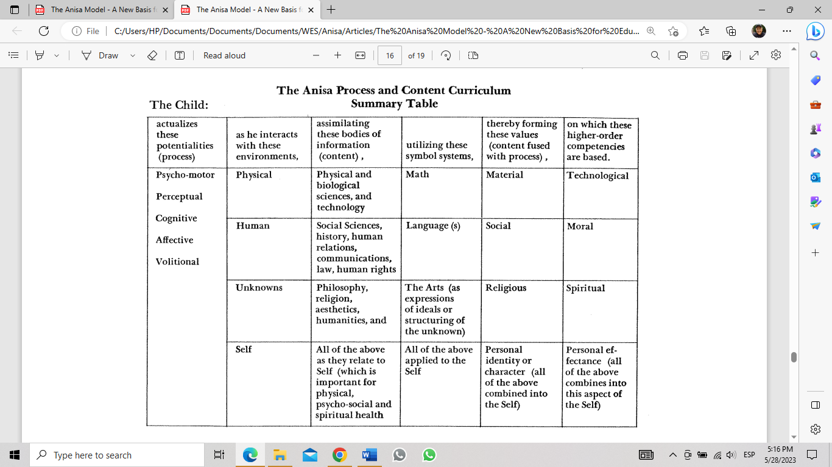
Notes:
From: “The Anisa Model: A New Basis for Educational Planning, ” Young Children, June, 1973, p304.

Slide 120
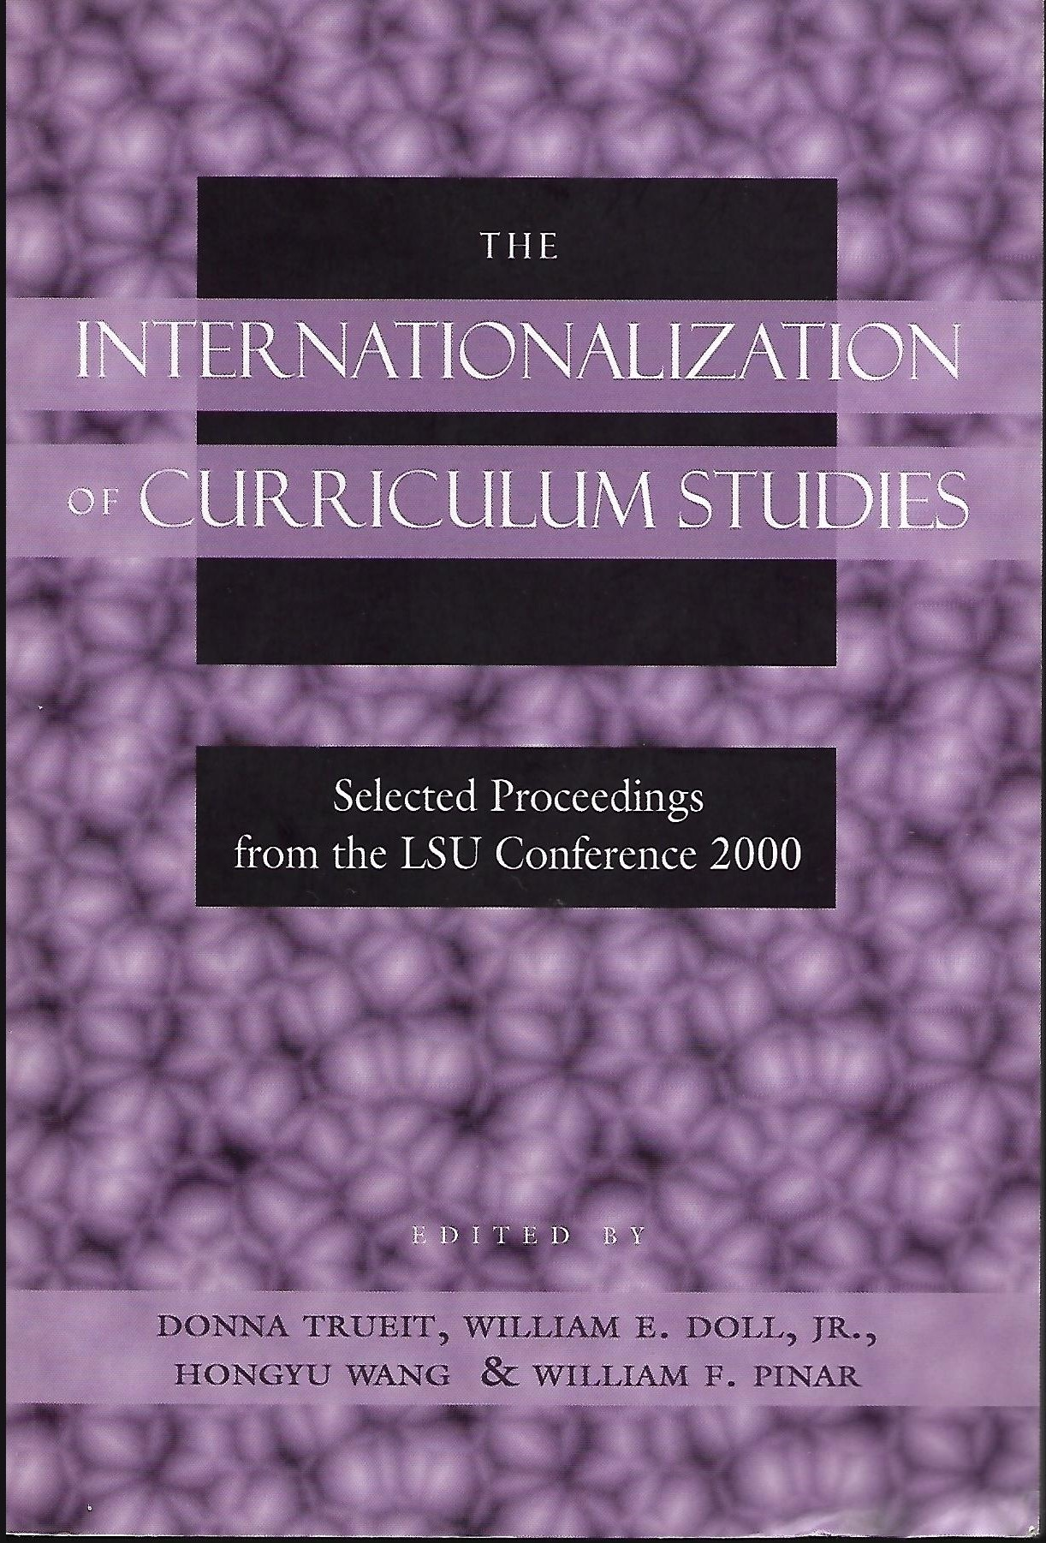
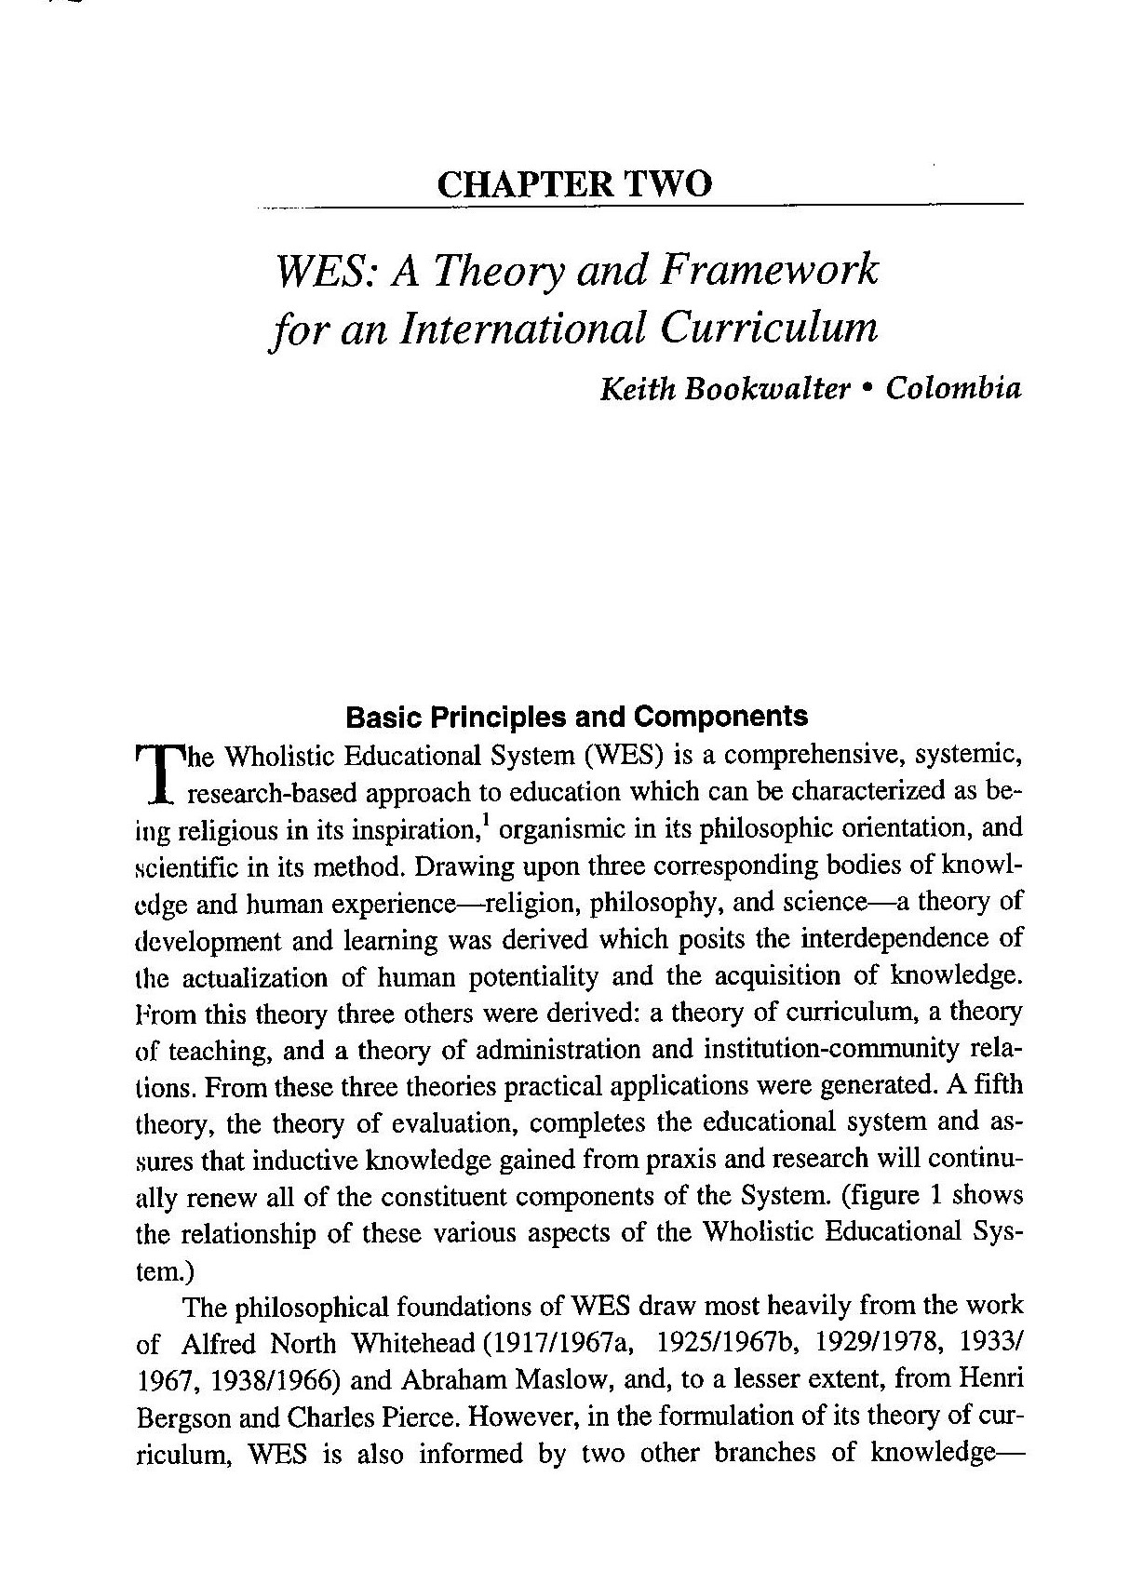
Notes:
"Chapter 2: WES: A Theory and Framework for an International Curriculum" in The Internationalization of Curriculum Studies: Selected Proceedings from the LSU Conference 2000, edited by Donna Trueit, William E. Doll, Jr., Hongyu Wang, and William F. Pinar, (New York: Peter Lang Publications, 2003).

Slide 121
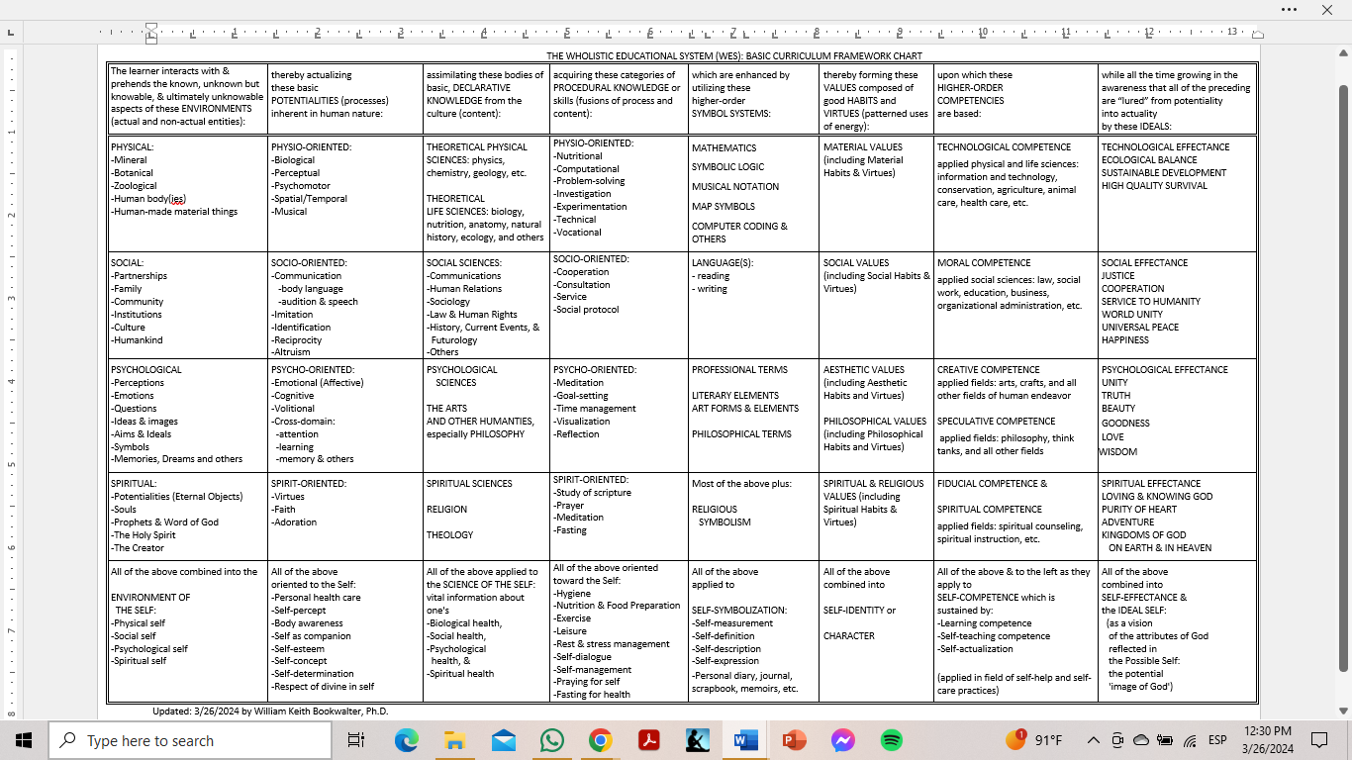

Slide 122
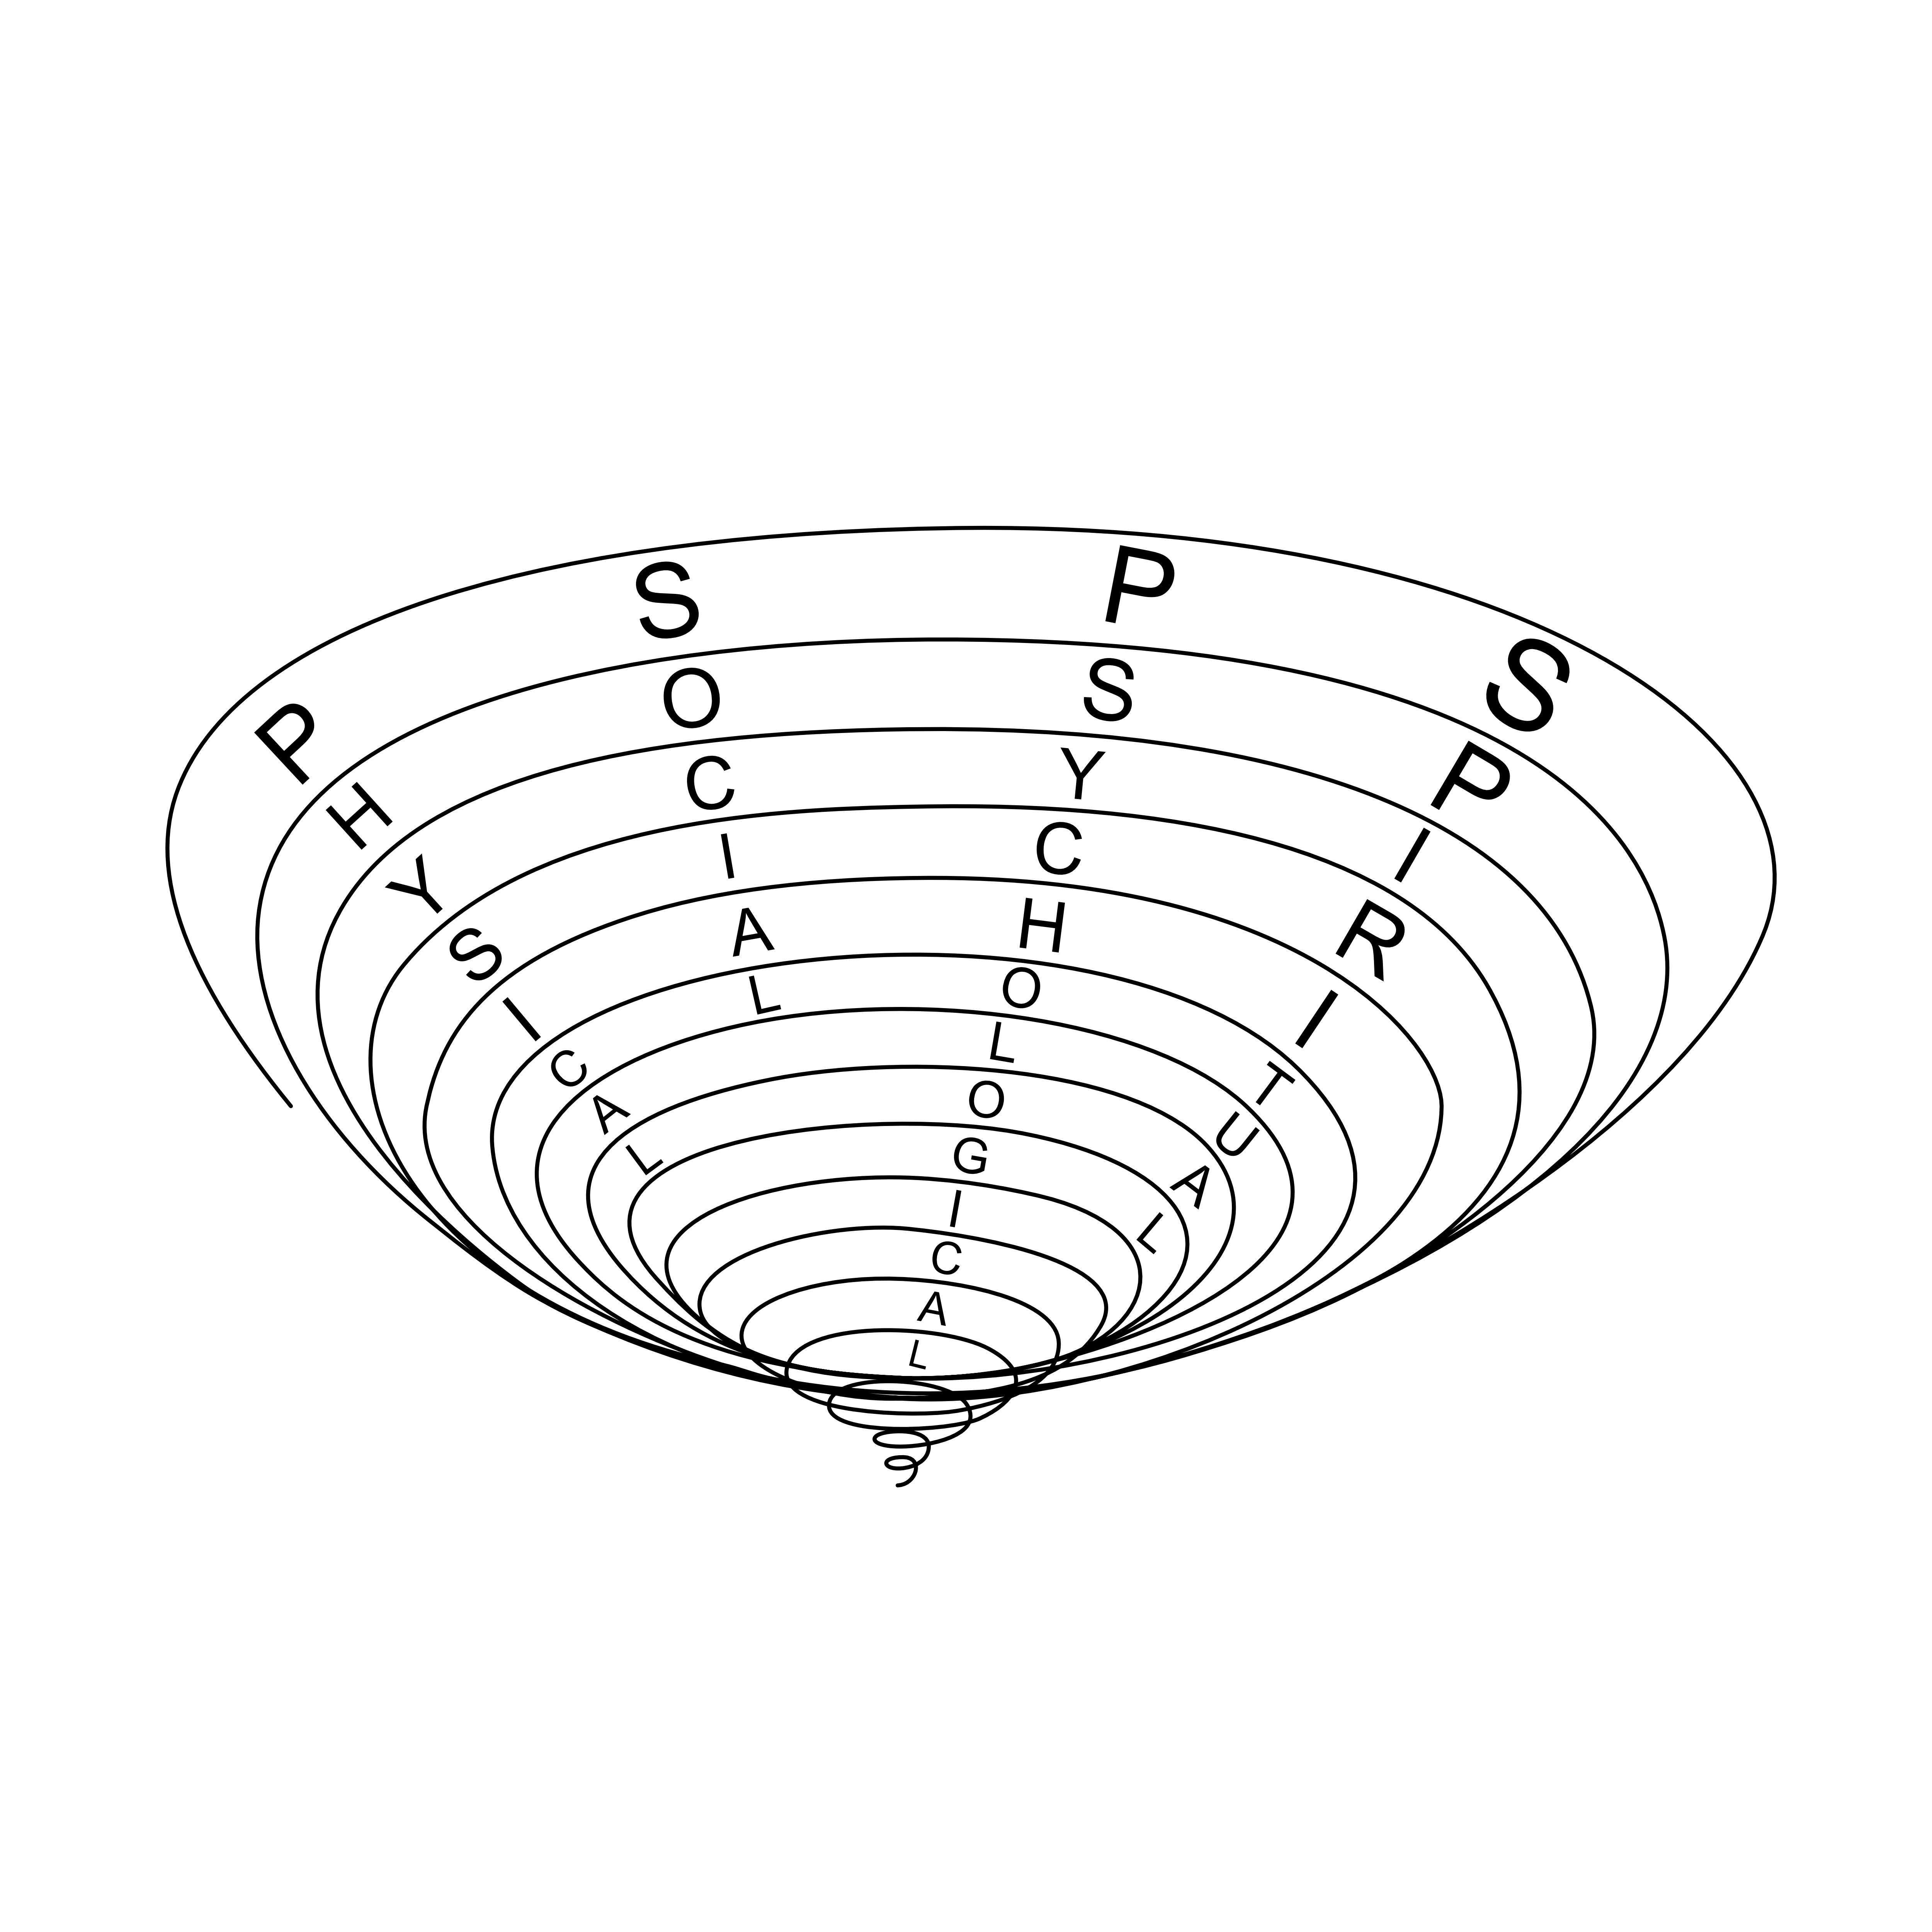
Notes:
This diagram is a visual metaphor for a spirial curriculum. Each spiral is a unit of study (or, unit of learning/teaching) that is ample enough to address all four dimensions as they are related to the them of study: physical, social, psychological, and spiritual. The unit could be as short as a single lesson or it could extend out into a day, a week, or several weeks deepending on the breadth and depth of the topic. As each loop of the spiral widens, as each unit of study or each school year passes, the learner’s competence in each of the four dimension increases, i.e., becomes more comprehensive, more precise, and more sophisticated. Based on the seamless, hierarchical connectivity of the four dimensions, interdimension integration is expressed in the vertical, curriculum strand titled, “higher-order competencies.”

Slide 123
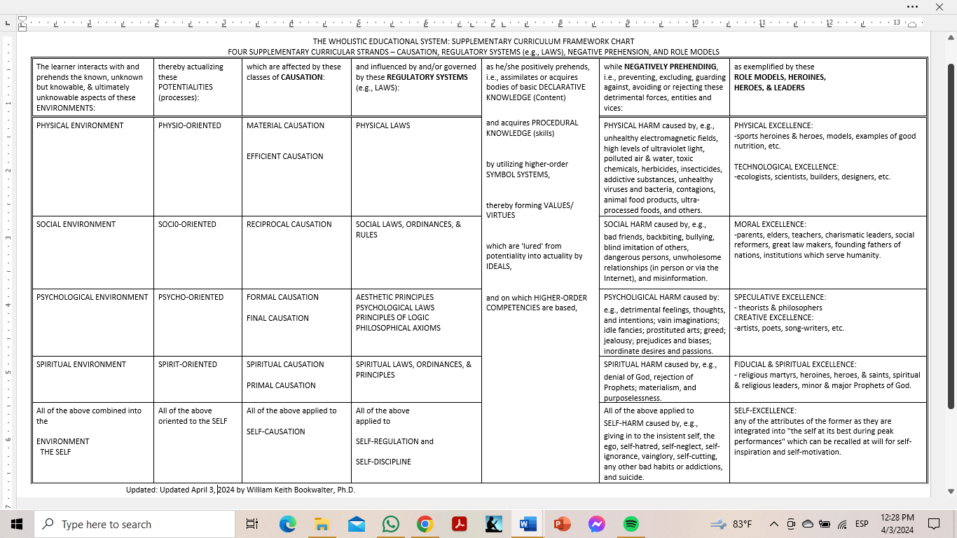

Slide 124
A LIFE IN DYNAMIC HARMONY (LDH)
SPIRITUAL
Teaching
Service
Tithing/Charity
Holy Days
Group Worship
PS
Y
C
O
L
O
G
I
C
A
L
Fasting
Prayer
Meditation
Scripture Study
Learning
Communication:
SOCI
AL
-Friends
Communication:
- Nature
- Self
- Spouse
- Children
- Family
Meditation
Goal-Setting
Time Management
Visualization
Reflection
Vocational
Development
-Faith
Community
?
-Work
Community
Hygiene
Nutrition
Exercise
Leisure
Rest
Creativity
-Society
Care of
Property
Budget
Work
PHYSICAL
THE CIRCLE OF LIFE IN DYNAMIC HARMONY
Notes:
A Life in Dynamic Harmony is a wholistic, multidimensional program for personal transformation created primarily for youth between the ages of 15 and 30 who are facing an ever-widening spectrum of responsibilities as they approach and enter higher levels of education, community service, adulthood, the world of work, marriage, and parenthood, and secondarily, for more mature adults who seek a more balanced, healthy, and wholesome lifestyle. The program sets forth four organizing principles–wholeness, transformation, the interdependence of the inner and outer aspects of life, and beauty; utilizes the universal archetype of the circle (especially as expressed in the Medicine Wheels of various Native American peoples) (1) as a quadratic, graphic organizer to facilitate centering and contemplation; (2) to regularly visualize one’s life in which the spiritual, physical, psychological, and social dimensions of life are developing in harmony with one another; and (3) to classify 36 basic, life processes such as prayer, nutrition, time management, and various types of communication, each of which is explicated in medium depth with quotations from famous authors and professionals in various fields and with personal experiences of the author.
This Universal LDH Medicine Wheel was presented to the students, faculty and parents at the Licéo Inglés in Pereira, Colombia. A poster-sized copy was used in the elementary counselor’s office as a mandala for reflection for students. A psychologist in Pereira and one in Manizales use this Wheel for therapy with their clients.

Slide 125
A LIFE IN DYNAMIC HARMONY (LDH)
SPIRITUAL
Teaching
Service
Tithing / Charity
Holy Days
Group Worship
P
S
Y COLOG
I
CAL
Lent
Prayer
Meditation
Scripture Study
Learning
Communication:
SOC
I
A
L
- Friends
Communication:
- Self
- Nature
- Spouse
- Children
- Family
Meditation
Goal-Setting
Time Management
Visualization
Reflection
- Church
Community
Vocational
Development
- Work
Community
Hygiene
Nutrition
Exercise
Leisure
Rest
Creativity
- Society
Care of
Property
Budget
Work
PHYSICAL
THE CIRCLE OF LIFE IN DYNAMIC HARMONY FOR CHRISTIANS
Notes:
Similar Circles of Life in Dynamic Harmony are pending for the followers of other religions such as Jews, Muslims, and Buddhists.

Slide 126
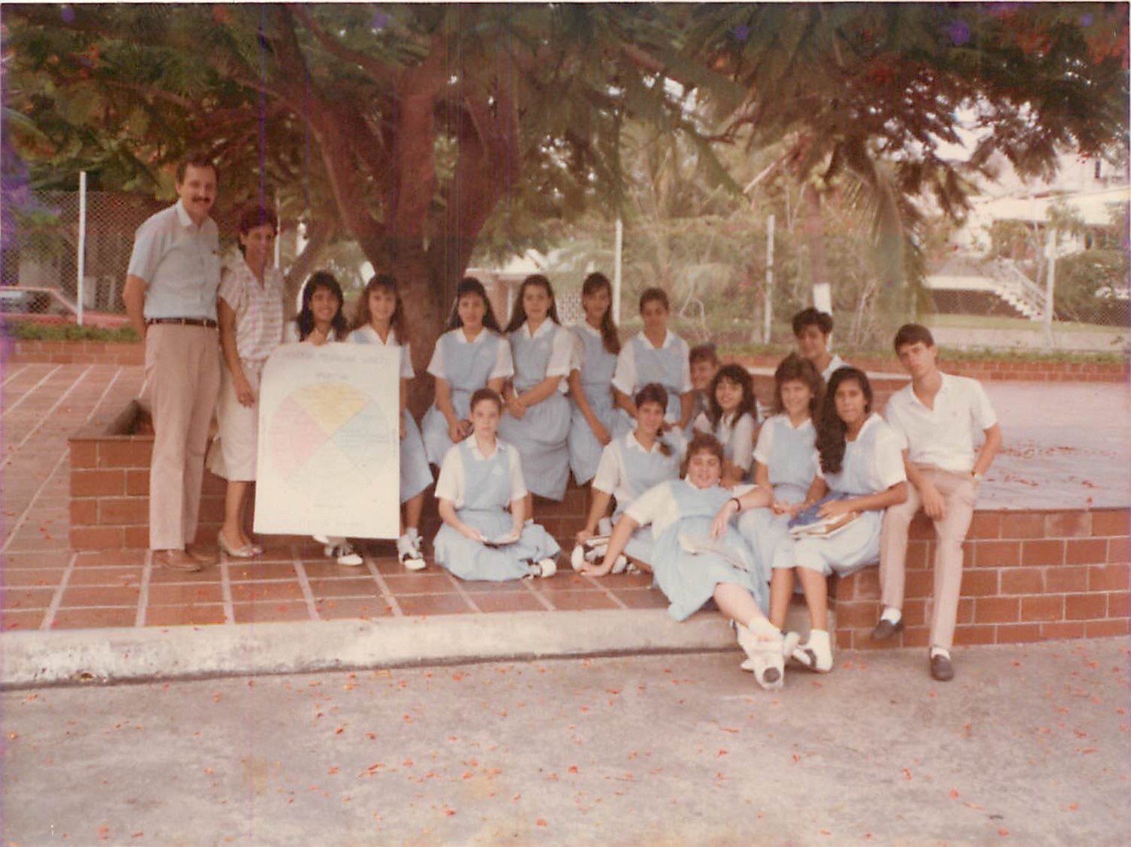
Notes:
1988, Barranquilla, Colombia, Marymount School: 12th grade English class with the universal Circle of Life in Dynamic Harmony, high school principal, and this author. Shanny Dacarrett, second from the right, told me in 2011 that her classmates still use the Wheel to manage their lifestyle.

Slide 127

A BAHÁ’Í LIFE IN DYNAMIC HARMONY (LDH)
SPIRITUAL
Teaching
Service
Holy Days
Devotional Meetings
19 Day Feasts
Huqúqu’lláh
Funds
PS
Y
COLOG
I
CAL
Communication:
Fasting
Prayer
Meditation
Deepening
Learning
SOC
I
A
L
- Friends
Communication:
- Self
- Nature
- Spouse
- Children
- Family
Meditation
Goal-Setting
Time Management
Visualization
Reflection
- Bahá’í
Community
Vocational
Development
- Work
Community
Hygiene
Nutrition
Exercise
Leisure
Rest
Creativity
- Society
Care of
Property
Budget
Work
PHYSICAL
THE CIRCLE OF LIFE IN DYNAMIC HARMONY FOR ADULT BAHÁ’ÍS
Notes:
This version of the Wholistic Circle of Life in Dynamic Harmony has been presented in Colombia at a Bahá’í Winter School in Cartagena, a 19-Day Feast in Pereira, and via two Zoom conferences for the community of Barranquilla and the Wayuu Bahá’í community of Rio Hacha, Guajira. It was displayed in the Bahá’í Center in Bucaramanga as a mandala for reflection and consultation.

Slide 128
The Developmental Activities Program (dap)
Compatible with WES, dap is a research-based, award-winning program for developing children’s abilities in logical thinking--classes, relations, number, topological space, projective space, Euclidean space, the measurement of Euclidean space, time, and the measurement of time—and the application of these cognitive structures to mathematics, and science process skills in preschool through grade 6 (in the U.S. system), i.e., ages 4 through 12.
Notes:
Bibliography:
William Keith Bookwalter, The Development of Logical Thinking in Children, (Saarbrücken, Germany: Lambert Academic Publishing, 2013).
Darrell G. Phillips, Structures of Thinking: Concrete Operations (Dubuque, IA: Kendall/Hunt, 1996).
Dale R. Phillips, Developing Logical Thinkers, (Dubuque, IA: Kendall/Hunt, 1999).
Darrell G. Phillips, Sciencing Toward Logical Thinking, (Dubuque, IA: Kendall/Hunt, 1994).
Dale R. Phillips, Darrell G. Phillips, G. Melton, and P. Moore, “Beans, Blocks, and Buttons: Developing Thinking,” Educational Leadership, 51 (5), (February, 1994): 50-53.

Slide 129
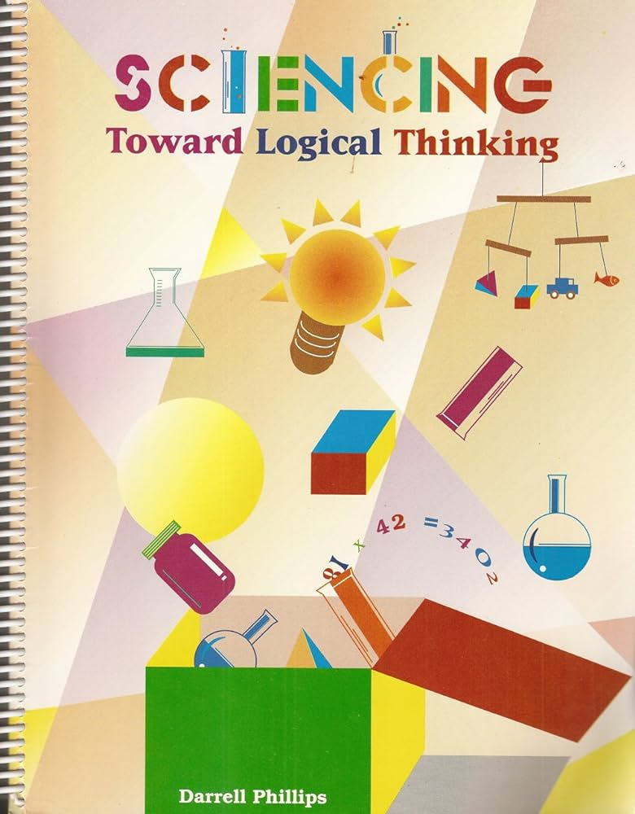

Notes:
Darrell G. Phillips, Structures of Thinking: Concrete Operations
Dale R. Phillips, Developing Logical Thinkers
Darrell G. Phillips, Sciencing Toward Logical Thinking
William Keith Bookwalter, The Development of Logical Thinking in Children

Slide 130
The theory of teaching has drawn on the work of:
- Jerome Bruner
- Phillip H. Phenix
- Harry S. Broudy
- B. Othanel Smith
- Woodruff
- Nathaniel L. Gage
- William Glaser
- Mary Elizabeth Mullino Moore
- Donald W. Oliver
Notes:
As with the other foundational sources, it is beyond the scope of this presentation to summarize the contributions of each of these theoreticians.

Slide 131
Theory of Teaching (A Pedagogy of Love)
Lovingly diagnosing: talents, strengths, interests, passions, goals, ways of learning and knowing, needs, weaknesses
Lovingly prescribing: motivating, purpose-guided interactions with particular environments
Lovingly arranging the environment(s)
Lovingly guiding interactions (with the environment) for the purpose of actualizing the learner’s potentiality at an optimum rate while absorbing wholesome entities and excluding unwholesome entities.
Lovingly assessing learning objective attainment (i.e., a new diagnosis)
Notes:
The term “teaching” was chosen for use in the title “Theory of Teaching” over the term “pedagogy” because the Greek root of the latter, “paid-” means boy and a pedagogue is defined as a “schoolteacher.” (Just as a pediatrician is a doctor of children.) The meaning of the term “teaching” is broader and can be associated with a broad range of ages of learners and be carried out by parents, coaches, master crafts persons, etc. It comes from the Middle English word “teching” which is akin to instructing, tutoring, training, educating and imparting information, understanding, or skill.
Nevertheless, today, “pedagogy” is used more broadly and the phrase “pedagogy of love” makes great sense and emphasizes the power of love and the ideal that everything a teacher does should be done with love and, of course, with appropriate feelings and acts of love that are in harmony with the culture and with morality.

Slide 132
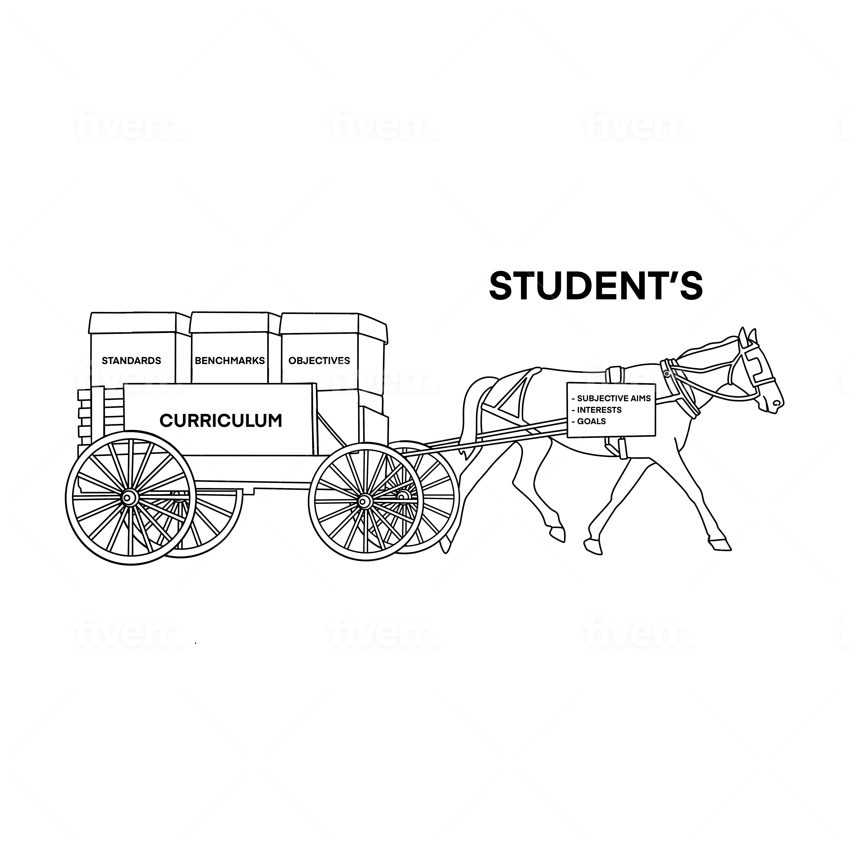
Notes:
This slide can be read as follows, “A teacher can increase the quality and rate of a learner’s acquisition of curricular standards, benchmarks, and learning objectives by integrating learning activities with each students’s, and/or the class’s interests, goals, and subjective aims which, in turn, “pull forward” or “lure forward” the learning process.

Slide 133
Self-teaching Competence
The conscious ability to:
- motivate one’s self by visualizing purpose-guided learning outcomes;
- diagnose one’s talents, passions, abilities, and needs;
- prescribe certain interactions with particular environments;
- arrange those prescribed environments; and
- guide one’s own interactions with them to:
- actualize one’s potentiality at an optimum rate, by:
- differentiating, integrating & generalizing experience,
- acquiring, absorbing (positively prehending) wholesome entities,
- and rejecting (negatively prehending) unwholesome entities.
- self-assess the attainment of learning objectives.
Notes:
The ultimate end of the WESian curriculum is not “learning competence” or “lifelong learning” which has the connotation that, when placed in an arranged environment, the learner will be competent in learning the object of knowledge. Self-teaching competence goes beyond these. When acquired, it equips the learner to become the teacher of one’s self and, in the course of her/his schooling, to gradually take charge of all of the processes that the teacher has been in charge of. It implies that the learner has a deep understanding of her or his self – learning style, abilities, knowledge, strengths, weaknesses, talents, goals, etc.

Slide 134
The Anisa theory of administration has been influenced by the work of:
- Chester Barnard
- Mary Parker Follett
- Chris Argyris
- Paul Hersey & Ken Blanchard
(Situational Leadership)
- Penny Walker (Anisa dissertation) and the WES theory of administration by that of:
- Lee G. Bolman & Terrence E. Deal
(Four-Frame Model)
Notes:
It is beyond the scope of this presentation to summarize the contributions of each of these theoreticians and to set forth the Anisa Theory of Administration which WES has adopted in its entirety. Please see the attached handout for a delineation of its postulates.
Notes:
At the beginning of the Anisa Model, there was no theory of administration, but it was soon realized that administrators, who could cancel an educational program or reduce its funding with the stroke of a pen, needed to be trained in the Model and that there needed to be a theory of administration coherent with the philosophy and theory of development to guide their work.
The Four-Frame Model of Bolman and Deal is fascinating. It examines these aspects of an organization: structural, human resource, political, and symbolic.

Slide 135
The first of the eight postulates
of the Theory of Administration
“Defines administration in terms of service qualified by the purposes and goals of the group or educational institution as specified in the theory of curriculum - a service that explicitly calls for administrators to have extensive knowledge about the goals and how they are to be achieved.”
Notes:
The theory of administration used in WES is that of the Anisa Model of Education. This slide points out that the type of leadership that is in harmony with the philosophy of Anisa and WES is “service leadership.” The other eight postulates can be found in the handout “Theory of Administration” and can be discussed in a future presentation. A corollary theory to the theory of administration is the WESian theory of learning community-environment relations.

Slide 136
Immanence
Trancendence
Present
Hi
Hi
Hi
Lo
Lo
Lo
Past events (+ -)
Heritage
Genetics
Ancestors
Traumas
Blessings
Accomplishments
Acquisitions
Mindfuiness
Future: Short to Long-range:
Plans
Goals
Expectations
Hopes and Dreams
Mission/Vision
New resources
Management
Leadership
Notes:
This slide illustrates the Whiteheadian concepts of “immanence” and “transcendence” which, I believe, are of special importance for the development of individuals, families, ethnic groups, races, societies, cultures, and the human race as a whole. Briefly, “immanence” refers to all past events, experiences, and accumulated knowledge and material entities. Transcendence refers to the future, i.e., intentions, plans, goals, and visions of possibilities, in short, the realm of potentiality. Whitehead emphasizes that the “present moment” is the only element of time that actually exists. That is, the past is over with and the future is yet to occur. Nevertheless, the quality of the present moment is colored and deeply impacted by one’s immanence and by one’s transcendence. The challenge for and task of educators is then threefold: (1) to enable students to understand, have great pride in, and build on the strengths of their immanence, that is, their personal past, their family’s past (including their accumulated, material wealth), their people’s and nation’s history, and that of the human race (without ignoring weaknesses, wrong-doings, and failures) – as the foundation and springboard for enabling them to (2) visualize inspiring future possibilities; and, thereby, enabling them (3) to make the necessary sacrifices for engaging in the current educational curriculum which will enable them to translate future possibilities into achievements.
In relation to administration, management is aligned with organizing, consolidation and caring for an educational institution’s immanence, that is, its history, its personnel, its accumulated funds, its physical plant maintenance, etc. Leadership is aligned with an educational institution’s transcendence, that is, its mission, vision, goals, strategic planning, fund-raising, recruiting, physical plant remodeling and building, expansion plans, etc.

Slide 137
The WESian
Theory of Learning Community-Environment Relations
Centralizes the function of administration to consciously guide the interaction of the learning community with the environment for the mutual purpose of reciprocally actualizing the potentialities of the learning community and its constituents while simultaneously actualizing the potentialities of the outer environment and its constituents.
Notes:
First of two postulates

Slide 138
Praxis
definition from Merriam-Webster Dictionary:
1: ACTION, PRACTICE: such as
a: exercise or practice of an art, science, or skill
b: customary practice or conduct
2: practical application of a theory
This component of WES provides for the inductive generation of knowledge via both action and formal research.
Notes:
Source: https://www.merriam-webster.com/dictionary/praxis
Action research is praxis-based and complements formal evaluation and research.

Slide 139
The Anisa theory of evaluation was developed from the work of:
-Lee Cronbach
-Ronald Hambelton &
Hariharan Swaminathan
-George Bondra

Slide 140
From the Anisa Theory of Evaluation, three of the ten postulates
1. Defines evaluation in terms of the purpose of the activity or program being evaluated;
2. Conceptualizes evaluation as an ongoing process that examines every aspect of program operation (including process and product or impact) and provides immediate feedback for its timely modification, including modification of the evaluation scheme itself;
3. Admits the ineffability of many vital aspects of human experience (thereby avoiding possible inadvertent biases proceeding from an unrecognized assumption that whatever is not measurable is not important);

Slide 141
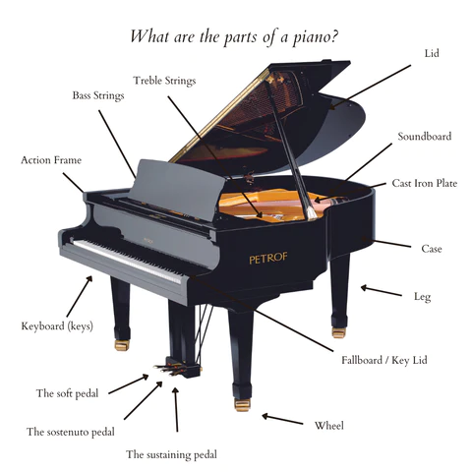
Notes:
The creation of WES for education is like the invention of the piano for music. The piano offers a common frame, a set of carefully designed and coordinated parts, that can be used by innumberable composers and pianists to produce an innumerable number and variety of musical compositions. WES offers educators a common framework and a unified set of fundamental, philosophical concepts, principles, and research-based theories which can be used by an innumerable number of educationists to produce a wide variety of comprehensive, coherent, and useful, research-based, educational programs.
Just as the purpose of the piano maker is not to offer the pianist or the composer the latest trends in performance styles or the most popular and beautiful compositions, but, rather, a long-lasting instrument that can be used by multiple generations and that can be used to transmit to others the high-quality sound of the best of musical compositions, . . . so it is that the purpose of WES is not to offer the most cutting-edge research on every aspect of education, but, rather, to offer a long-lasting scheme of thought and set of theories that will enable multiple generations of educationists to créate and organize educational programs that will have the qualities of beauty—balance, order, unity, contrast, and harmony; educational programs that will be able to incorporate leading-edge innovations and research in the field. Just as musical compositions and songs are continuously being produced and music is constantly evolving, so will knowledge, praxis, and approaches evolve in the field of education. Regarding general knowledge, it has been estimated that in 1900, it was doubling every century; in 1945: every 25 years, in 1981: every 8 years; in 2023: estimates range from 13 months to every 12 hours. This is a major challenge for education, especially for the design of the content curriculum which needs to contain the selection of knowledge that wise educators believe that students should acquire in order for them to survive, to thrive, and to enjoy life in both the present and the future.

Slide 142

Upon this gifted age / In its dark hour / Rains from the sky a meteoric shower of facts; / They lie unquestioned, uncombined, / Wisdom enough to leech us of our ills / Is daily spun, / But there exists no loom / To weave it into fabric. – Edna St. Vincent-Milay
Notes:
The “loom” of Edna St. Vincent-Milay is another metaphor that can be used to understand WES as a framework for organizing the knowledge and skills needed to educate the whole child and the upcoming generations. Knowledge of a loom, its purpose, its parts, and how it functions does not include the latest developments in thread composition, dyes, and weaving patterns. But without the loom, these would lie dormant in a storage room. Likewise, knowledge of WES, its purpose, its philosophy, its theories, and its practice, does not include the latest research on human development and learning, teaching strategies, and governance, but without WES, these have been put together in a hodge-podge, hit-and-miss fashion.
The “WESian loom” will also help teachers to become more professionally autonomous and capable of clarifying and justifying their developmental approach as they confront “one size (and timeframe) fits all” mandates.
From time to time looms have been updated and improved in their design, materials, size, etc. WES also, via continual evaluation, will be improved.
May your work carry forward the use of and development of this “loom” as you weave beautiful fabrics of educational experiences for learners and their present and future happiness!

Slide 143
Part 4:
Possible Applications
of the Wholistic Educational System
at Educational Institutions
that Are Interested in
a Multidimensional, Developmental
Approach to Education
(18 slides)

Slide 144
At all levels of education:
1. As a leading-edge paradigm for understanding the nature of reality that can be shared by all of the members of the learning community.

Slide 145
2. As a template for examining the institution’s programs in order to find areas of overlap and compatibility and areas that the institution is not addressing, i.e., program gaps.

Slide 146
3. As a filter for program adoption and adaption for the various curricular areas, that is, to find programs that are in harmony with the organismic, holistic, developmental paradigm.

Slide 147
As a set of four “lenses” – physical, social, psychological, and spiritual -- for viewing life both as a whole and as having multiple dimensions; a set of “lenses” for examining:
  a. any phenomena that are within any one of these
  four domains and phenomena that span any
  combination of them,
b. problems to be solved,
c. programs to be created or developed, and/or
d. goals to be achieved.

Slide 148
5. As a general system of education to be integrated with the learning community’s particular mission, vision, and culture (internal and external) in order to create its own unique model of education that can be replicated in similar cultures.

Slide 149
6. As a basis for training programs that vary in complexity, for current and new faculty members, administrators, staff members, and parents in order for all of the learning community members to approach education with a shared understanding of its nature and purposes.

Slide 150
7. As a framework for developing the curriculum and for guiding course designs.

Slide 151
8. As a voluntary, personal development program for faculty members, administrators, staff members, students, and parents utilizing its “curriculum of the self” and the Life in Dynamic Harmony program with its circular, graphic organizer which serves as an archetype for self-transformation.

Slide 152
9. As a cutting-edge, inspiring innovation for attracting:
a. donations for special projects and
endowment funds for both expansion and
consolidation, including student
scholarships.
b. highly qualified faculty members and
other personnel.
c. students of the highest caliber and
potential.

Slide 153
At the level of higher education:
10. As a foundational course for new students and, at a higher level of complexity, as a post-graduate course for professionals.
Notes:
It would also be recomendable to create a course on WES for each year of studies, for example, WES 101, 102, 103, and 104 with each level being more complex in its concepts and applications.

Slide 154
11. As a framework for a research program that fuses WES, the educational institution’s programs, and the scheme used by the Encyclopedia of World Problems and Human Development: http://encyclopedia.uia.org/en, especially its organization of problems at the micro, meso, and macro levels; its values; its strategies; its content, and other aspects.

Slide 155
12. In relation to research, as a basis for justifying the inclusion of the physical, social, psychological, and spiritual dimensions with each problem description and the strategies for solving or alleviating the problem.

Slide 156
13. As a matrix for creating a data base of local, regional, national and international problems.
Notes:
Especially for the more localized problems, include in the description, estimates of the degree of seriousness of the problem and the number of people impacted by each problem. (Other universities NGO’s, associations, etc. in the country could be invited to contribute to the data base . . . along the lines of the Union of International Associations in Brussels.)

Slide 157
14. As a stimulus for students and faculty members to publish articles on their research findings and strategies and to contribute these to the data base of the institution and to the Encyclopedia of World Problems and Human Development.
Notes:
Although not as common, whenever the means can be provided, educators at the early childhood through the secondary level should be encouraged to and receive support in order to, carry out action and formal research and publish their findings.

Slide 158
The Wholistic Education System (WES):
A Multidimensional, Developmental Approach
William Keith Bookwalter, Ph.D. kbookwalter@gmail.com
W
E
S
Notes:
See the last handout for concluding remarks for the audience.

